Slide 1

Economics for Public Policy
LECTURE 11.
GOVERNMENT 1 – SPENDING AND DEBT
Richard Davies
Winter Term, 2024

Slide 2



In the news – Debt – February 2024 Large countries at risk of default
Pakistan (5). Needs $22b + to service external debt and pay bills for fiscal year 2024. Inflation and interest rates historic highs. Devastating 2022 floods. $3 billion IMF bridge loan in July. Loans also from Saudi Arabia and the UAE.
Ethiopia (12). Impact of civil war. (Financial Times, here).
Egypt (14). Owes $100b hard-currency debt over the next five years. 40% of revenues spent on interest payments.

Slide 3
Macro menu Where we’ve been, and where we are heading….
Previous weeks:
GDP and growth
Jobs and wages
Currencies and inflation
Today:
Government spending, deficits and debt
Facts: government
What does the government spend on?
Deficits
What happens when income is less than spending?
Sovereign debt
How does it work?
Debt crises
How much is too much?
Next: Taxation and Fiscal Stimulus
Then: Long-term trends
Notes:
Class discussion

Slide 4
The public purse What does the government spend on?

Slide 5
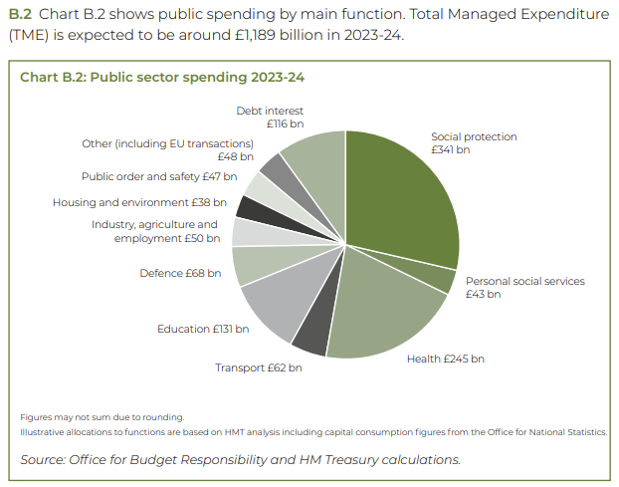
Spending - UK What does the government spend on?
UK Budget, 2023
Notes:
https://www.cbo.gov/

Slide 6
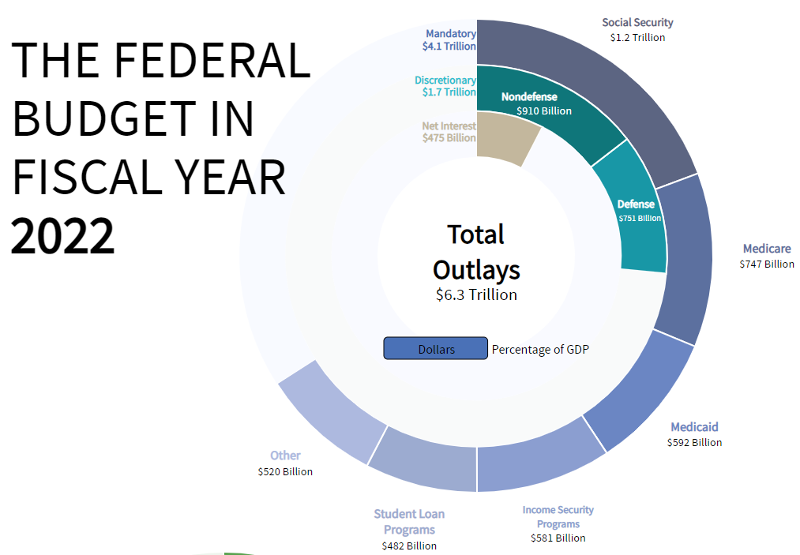
Spending - US What does the government spend on?
Notes:
https://www.cbo.gov/

Slide 7
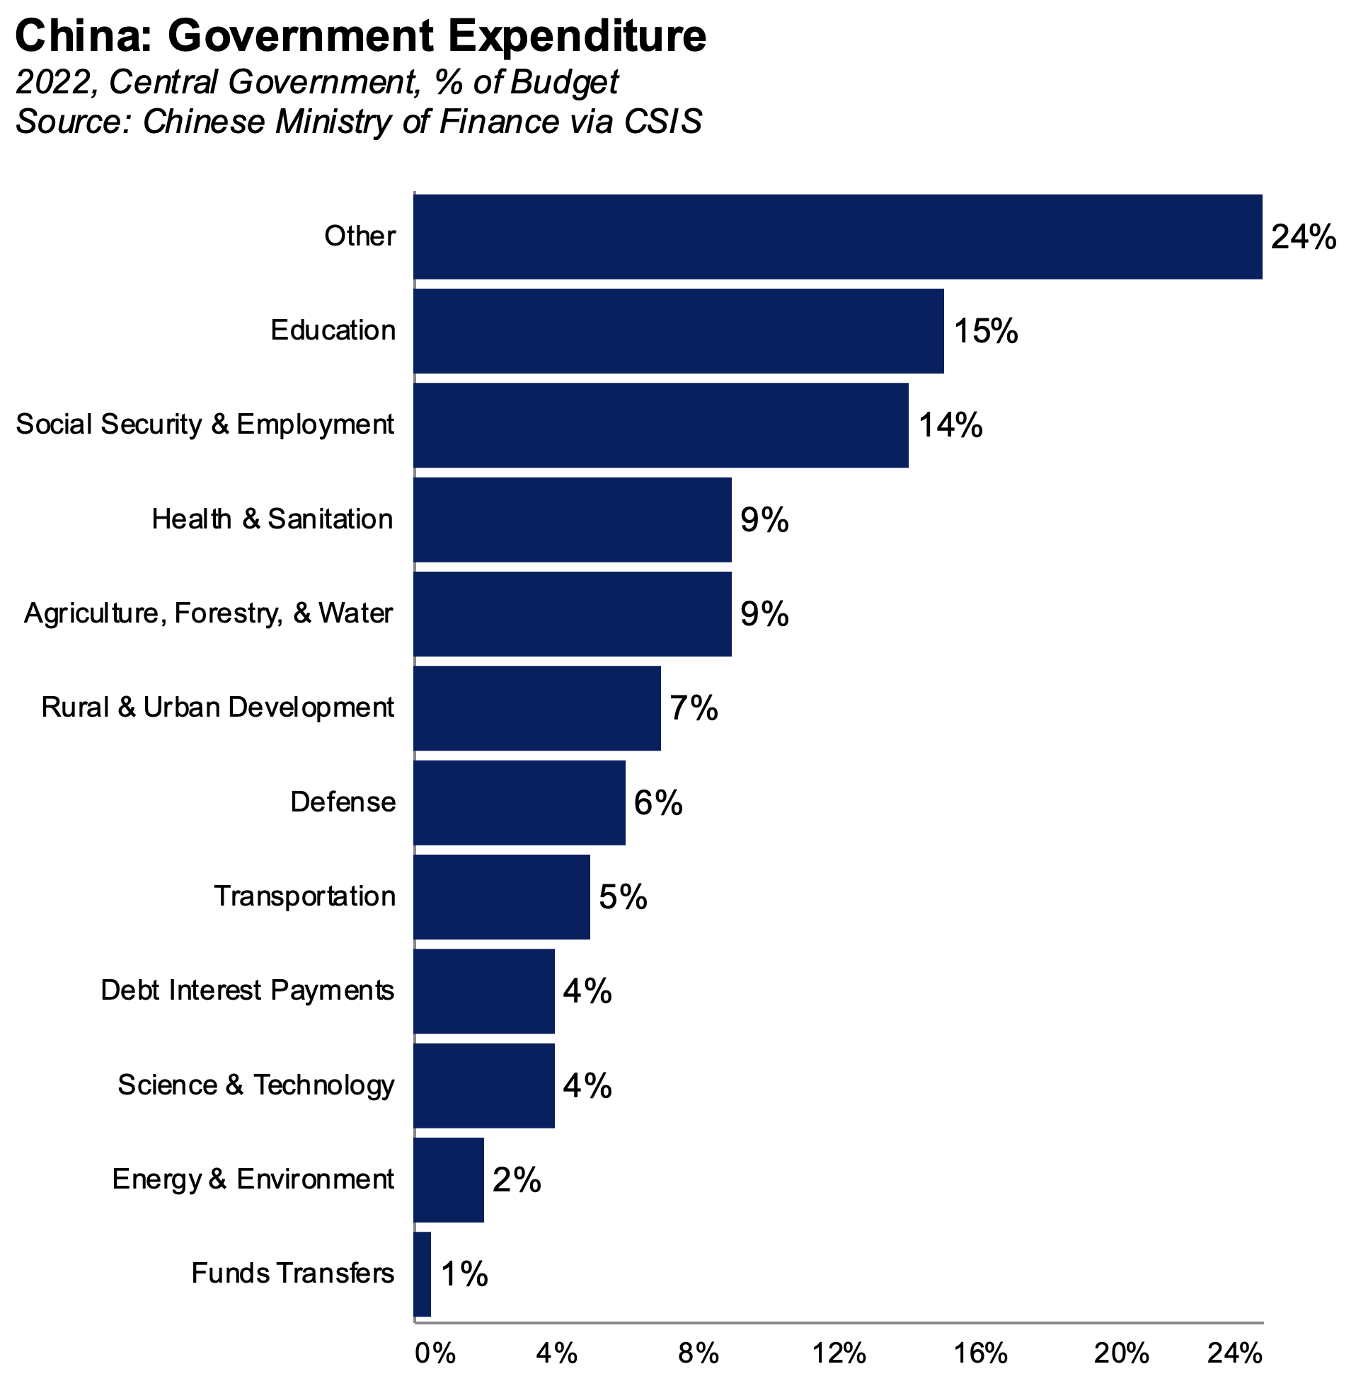
Spending - China What does the government spend on?
Notes:
https://www.cbo.gov/

Slide 8
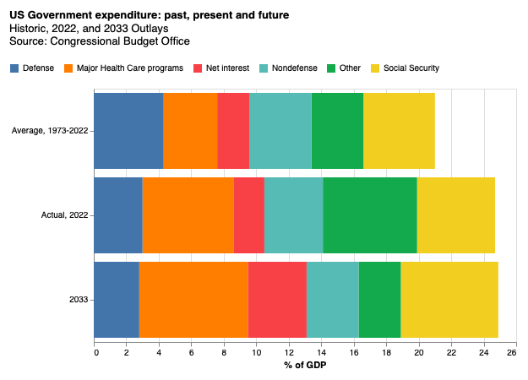
Spending: past, present, future US Government expenditure: historic, 2022, and 2033.
Notes:
https://www.cbo.gov/
https://www.cbo.gov/system/files/2023-02/58848-Handout-By-the-Numbers.pdf

Slide 9
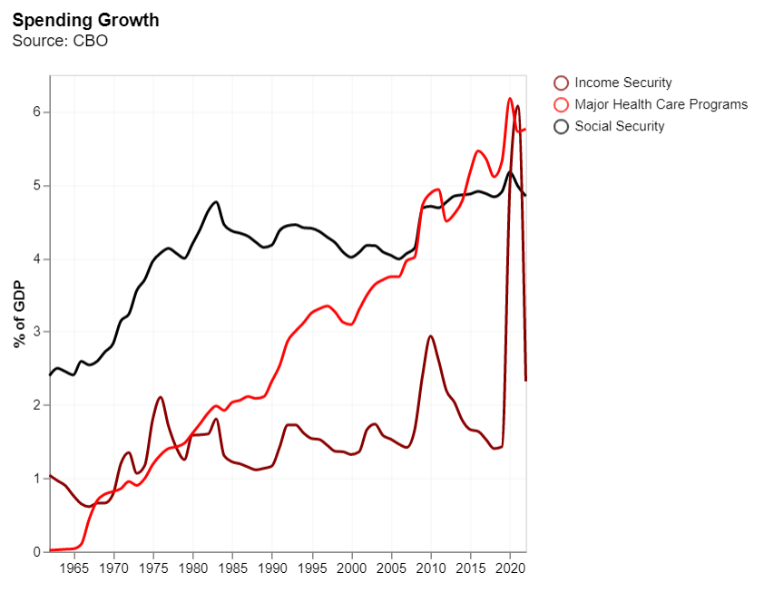
Spending growth The budgets that are rising
Notes:
https://www.cbo.gov/

Slide 10
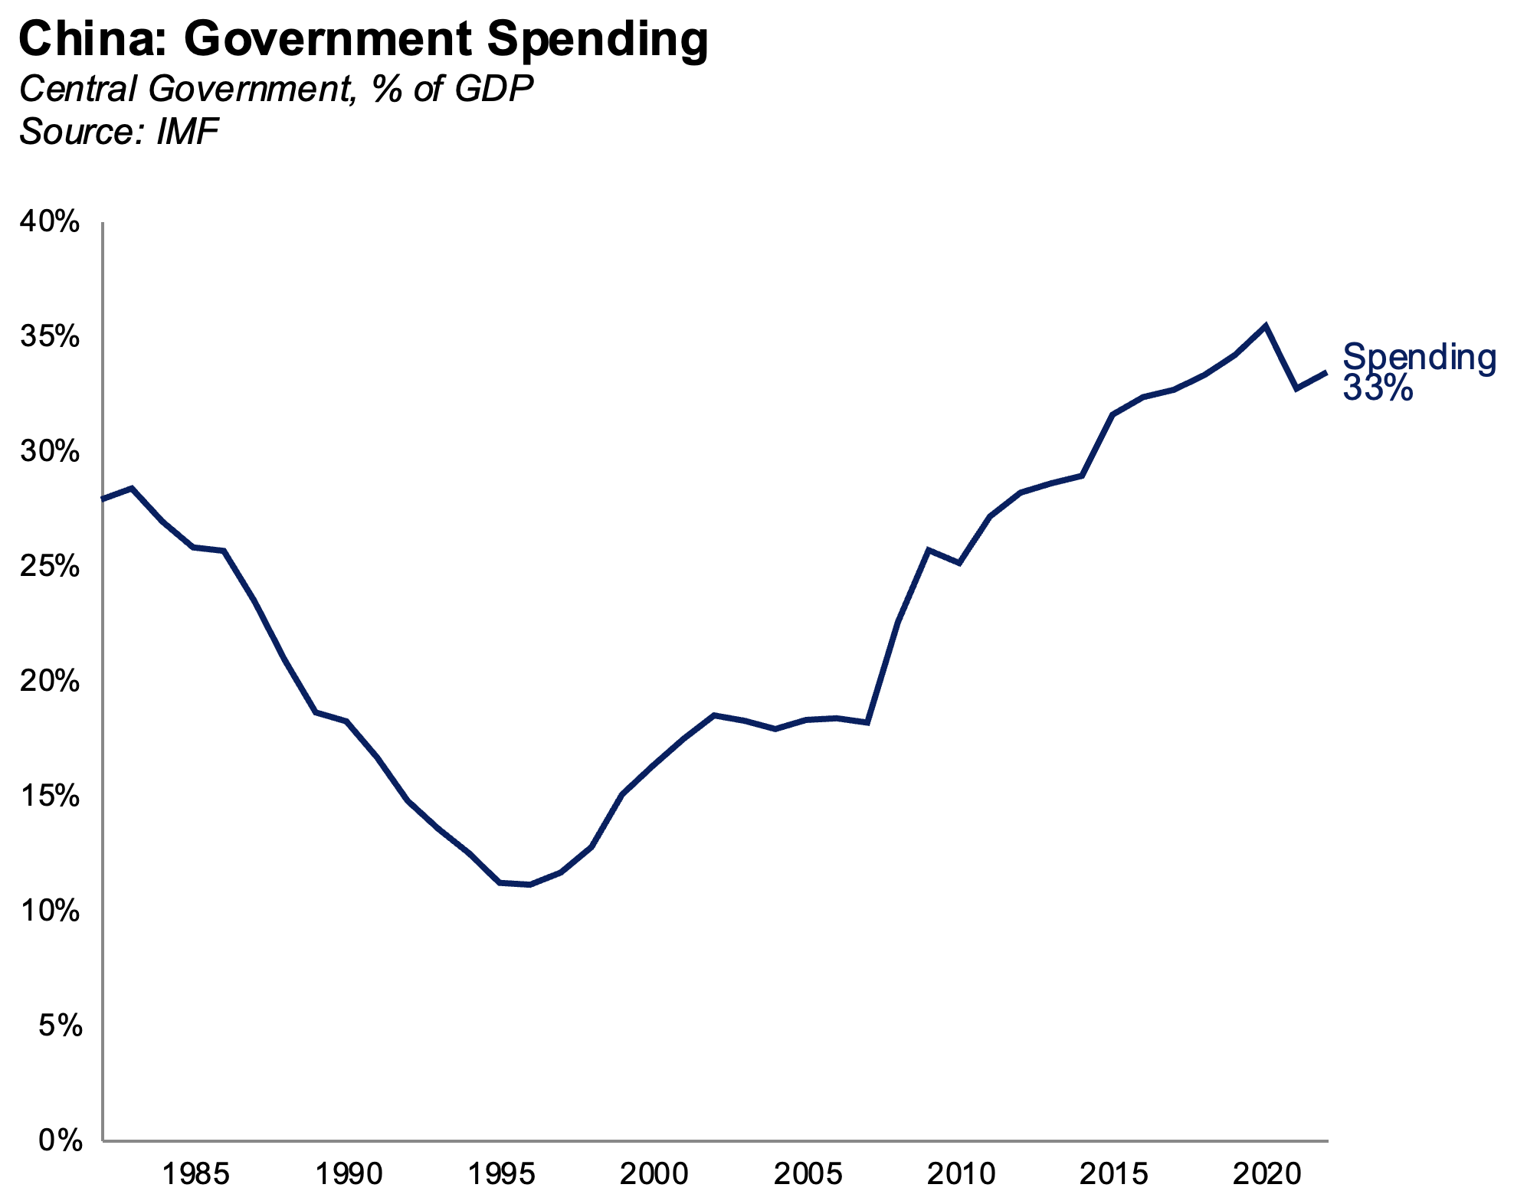
Spending growth The budgets that are rising
Notes:
https://www.cbo.gov/

Slide 11
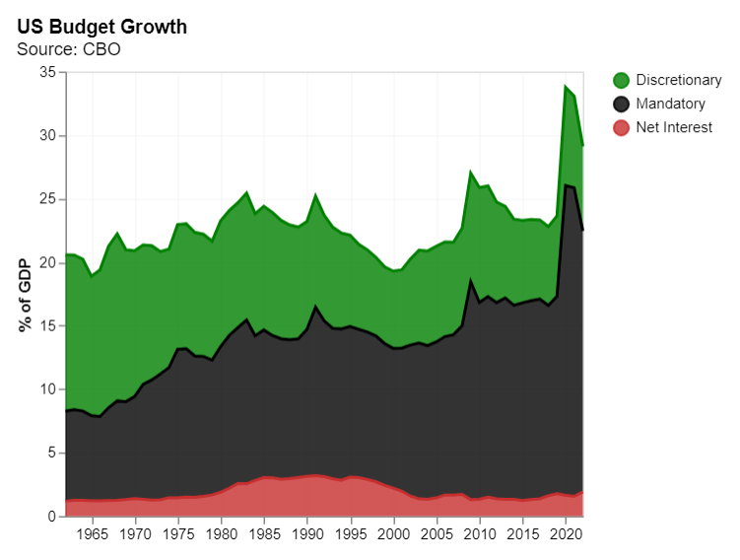
Shifting spend The changing nature of the US budget
Notes:
Columns B E and K in Tab 5a.
https://www.cbo.gov/system/files/2023-02/51118-2023-02-Budget-Projections.xlsx

Slide 12
Ever larger, less flexible What do we take from the charts above?
Spending is rising as a percentage of GDP
The nature of spending has shifted
Discretionary spending has fallen
Mandatory programs—the hardest to adjust—are an ever-bigger share
This is forecast to continue
So, the budget is larger, and less flexible.
Question for today: What are the implications of this? What might be the implications for arts funding.
Notes:
https://www.cbo.gov/

Slide 13
Deficits
What happens when income is lower than spending?

Slide 14
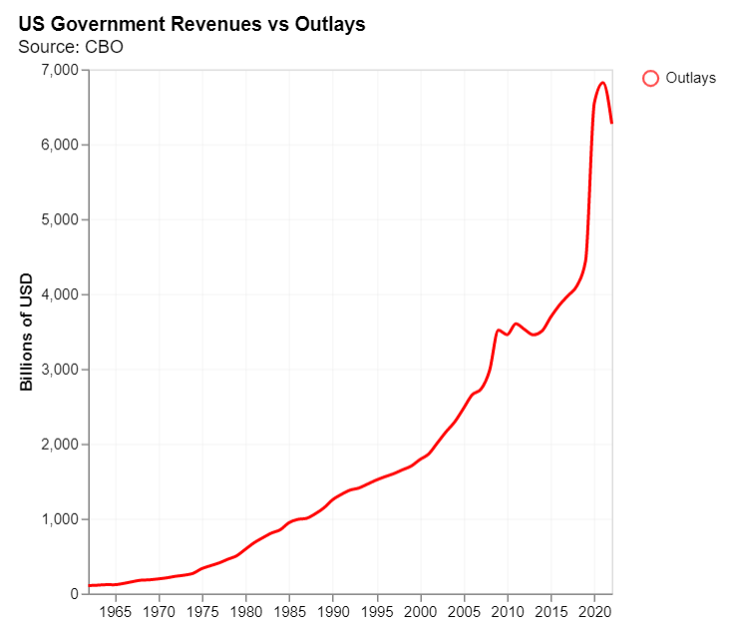
US Treasury: money in, money out Revenues versus outlays
The latest spending data is always alarming.
But remember our data discussion.
Is this a good piece of analysis?
Notes:
Class discussion

Slide 15
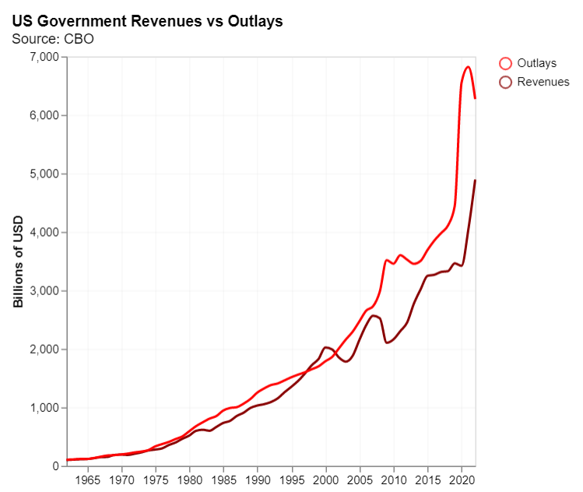
US Treasury: money in. money out Revenues versus outlays
Revenues also rise over time…
Notes:
Class discussion

Slide 16
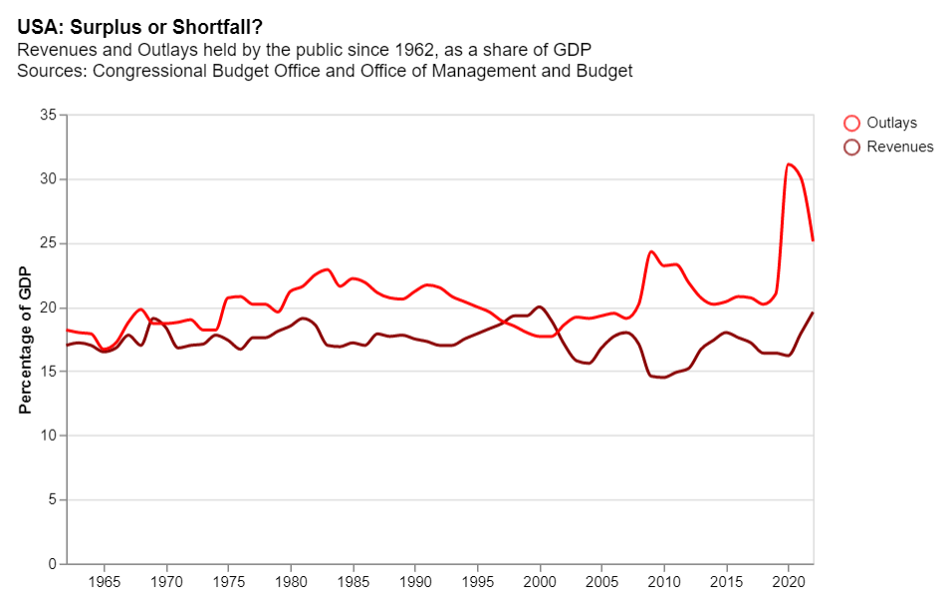
USA: surplus or shortfall? As a percentage of GDP things look better. But there is still a sizeable deficit.
As a share of GDP
Notes:
Columns B and C, Tab 1a
https://www.cbo.gov/system/files/2023-02/51118-2023-02-Budget-Projections.xlsx

Slide 17
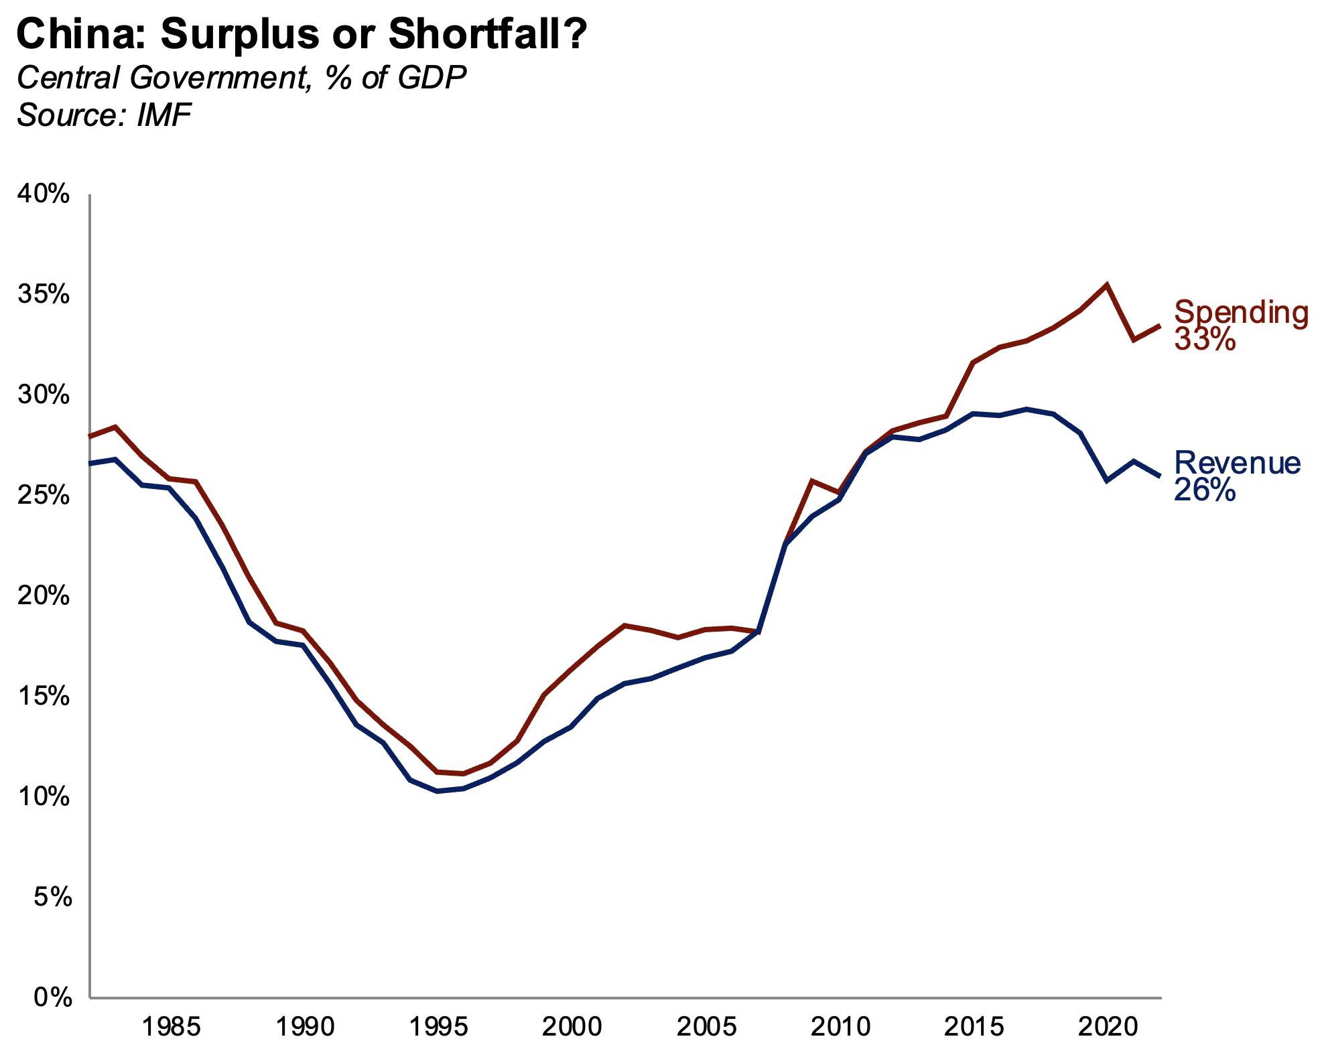
China: surplus or shortfall? Revenues versus outlays
Notes:
Columns B and C, Tab 1a
https://www.cbo.gov/system/files/2023-02/51118-2023-02-Budget-Projections.xlsx

Slide 18
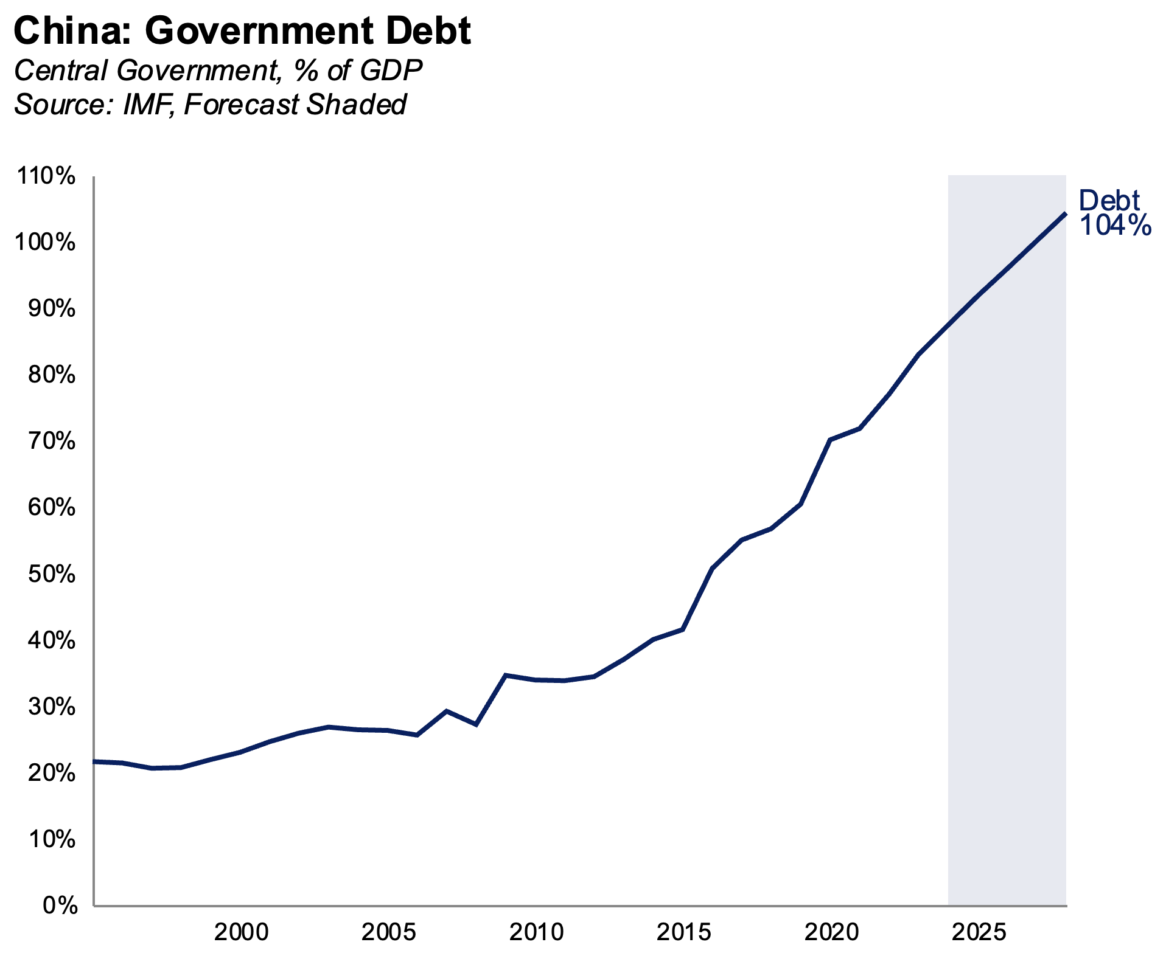
China: surplus or shortfall? 104% of GDP by 2028?
Notes:
Columns B and C, Tab 1a
https://www.cbo.gov/system/files/2023-02/51118-2023-02-Budget-Projections.xlsx

Slide 19
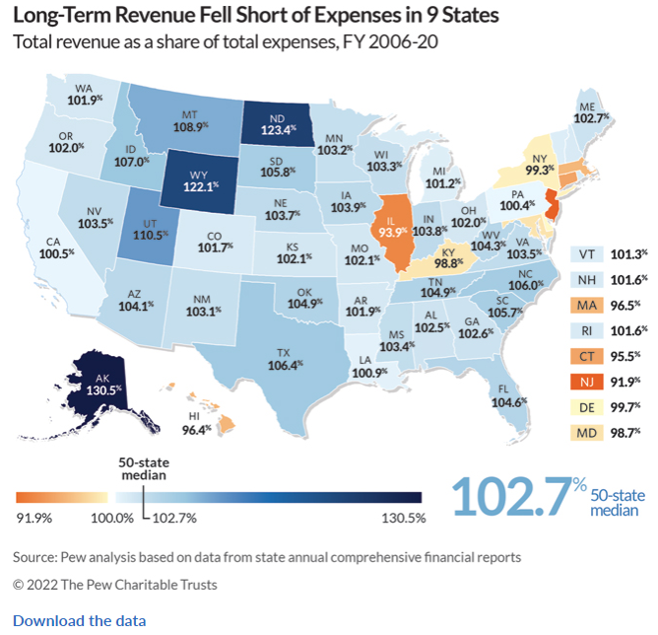
US states: budget deficits State level deficit
US State Deficits. Pew Trust
Mini project 2.
Does your state have a surplus or deficit? Why?
Notes:
https://www.mercatus.org/media/51041/download#:~:text=State%20debt%20is%20calculated%20from,of%20state%20total%20personal%20income.

Slide 20

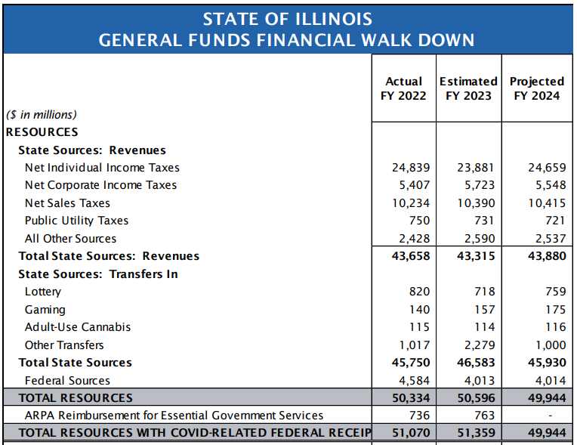
Illinois: budget State level deficit
You should be able to find your state budget on line.
Most will have a summary quite near the start.
Illinois State Budget 2024. (Link)
Notes:
https://www.mercatus.org/media/51041/download#:~:text=State%20debt%20is%20calculated%20from,of%20state%20total%20personal%20income.

Slide 21
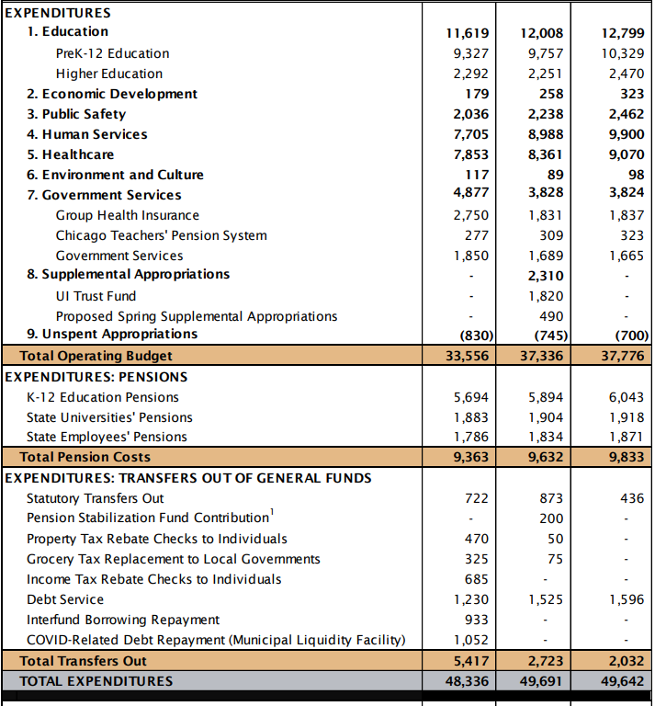
Illinois: budget State level deficit
How does Illinois budget look?
I think there are reasons to worry….
We will return to this later.
Notes:
https://www.mercatus.org/media/51041/download#:~:text=State%20debt%20is%20calculated%20from,of%20state%20total%20personal%20income.

Slide 22
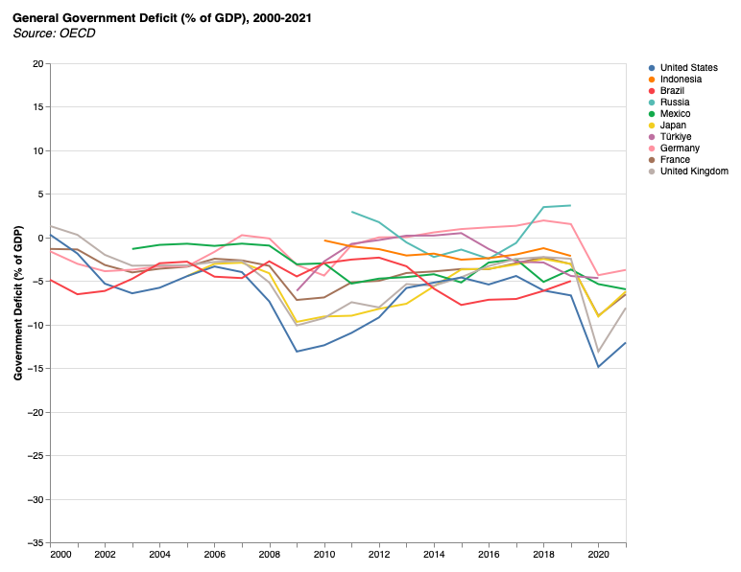
Global view: budget deficits Budget deficit, by country. Selection of our large, P21, countries
Notes:
https://data.oecd.org/gga/general-government-deficit.htm

Slide 23
Fiscal policy: frameworks Fiscal councils, Budget watchdogs
Important policy development over past 30 years: fiscal rules and independent fiscal oversight.
Policy problem: short-term political incentives. Bias towards debt.
Policy responses:
Fiscal rules.
Independent fiscal oversight. [UK example: https://obr.uk/]
Notes:
https://data.oecd.org/gga/general-government-deficit.htm

Slide 24
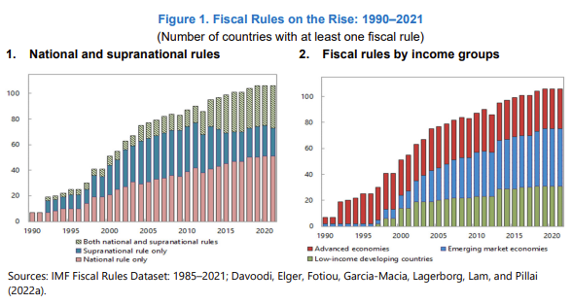
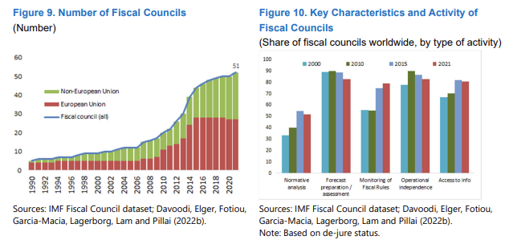
Independent Oversight The rise of rules and oversight
Fiscal rules ↑
Fiscal councils ↑
IMF paper (2022)
Notes:
https://data.oecd.org/gga/general-government-deficit.htm

Slide 25
Sovereign Debt
How does it work? Why so important?

Slide 26
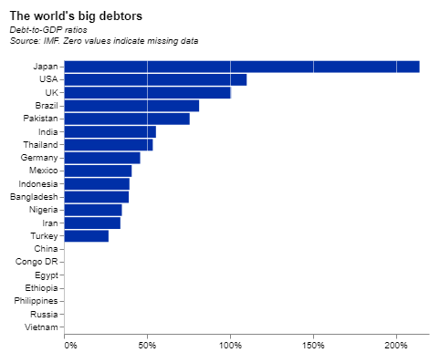
Debt outstanding Who are the world’s greatest debtors?

Slide 27
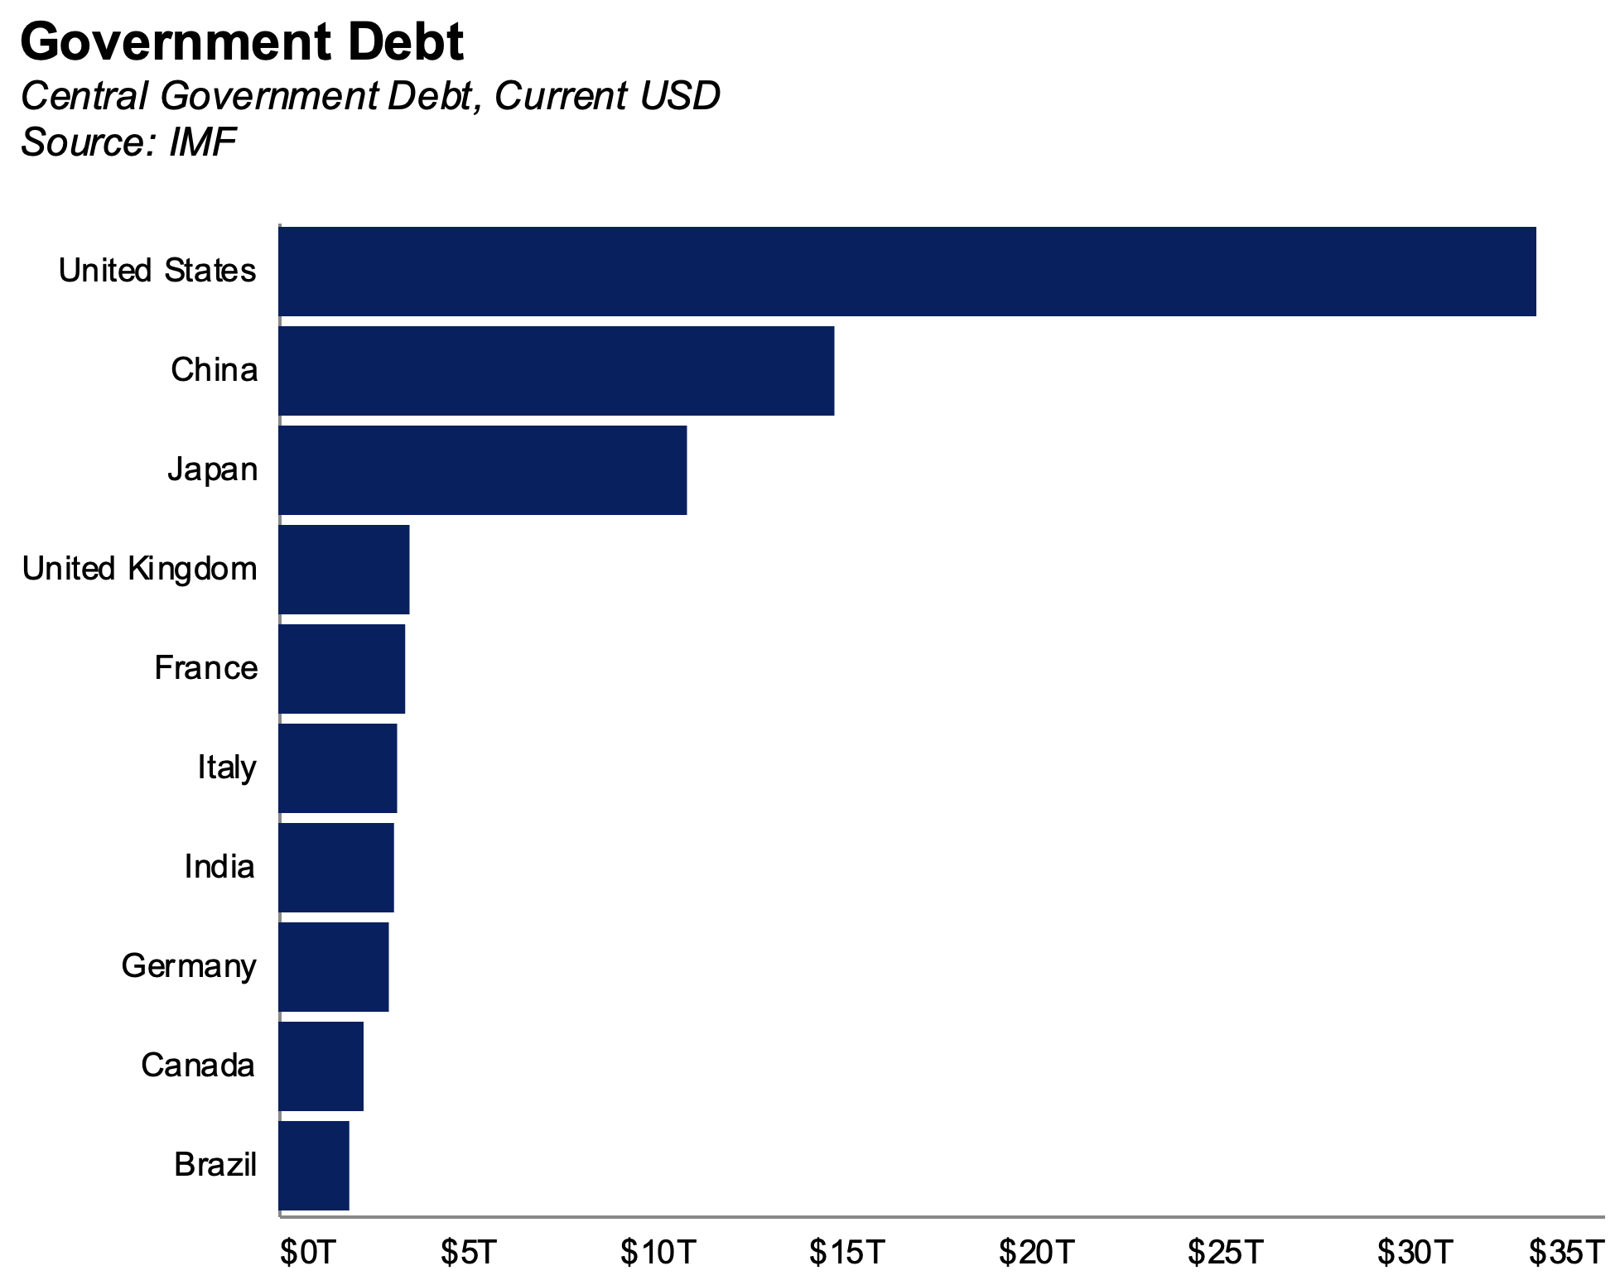
Debt outstanding Who are the world’s greatest debtors?

Slide 28
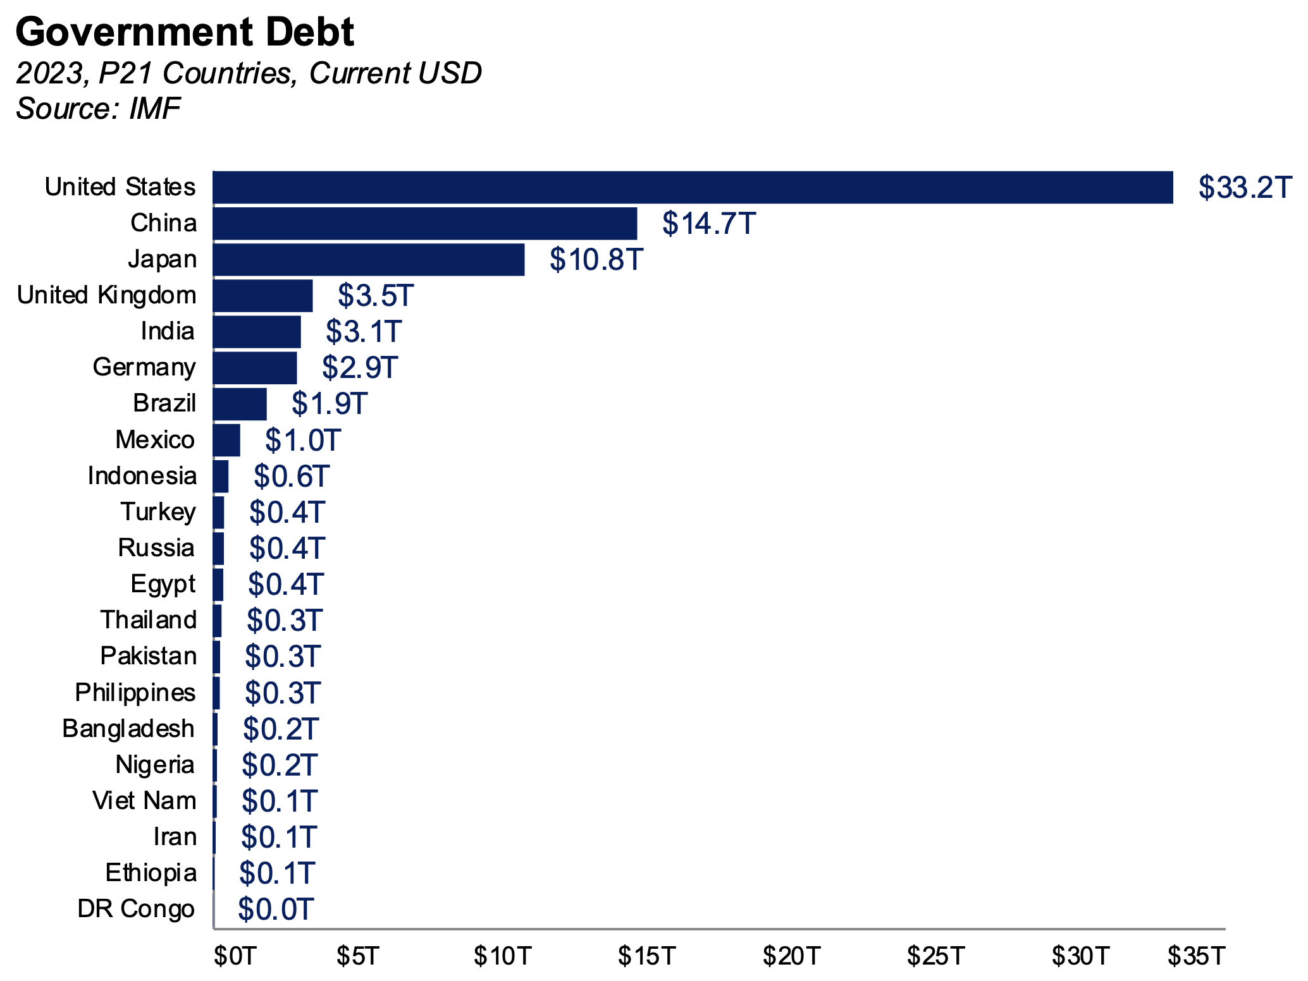
Debt outstanding Debt held by P21 countries

Slide 29
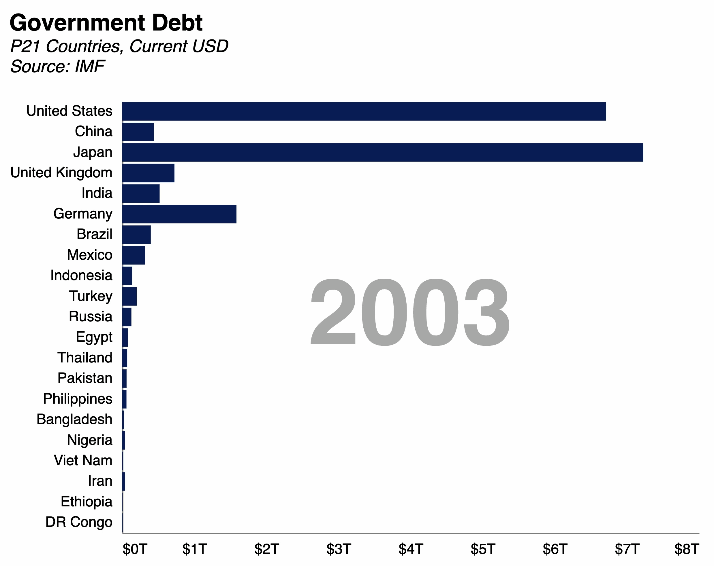
Debt outstanding How did we get here?

Slide 30
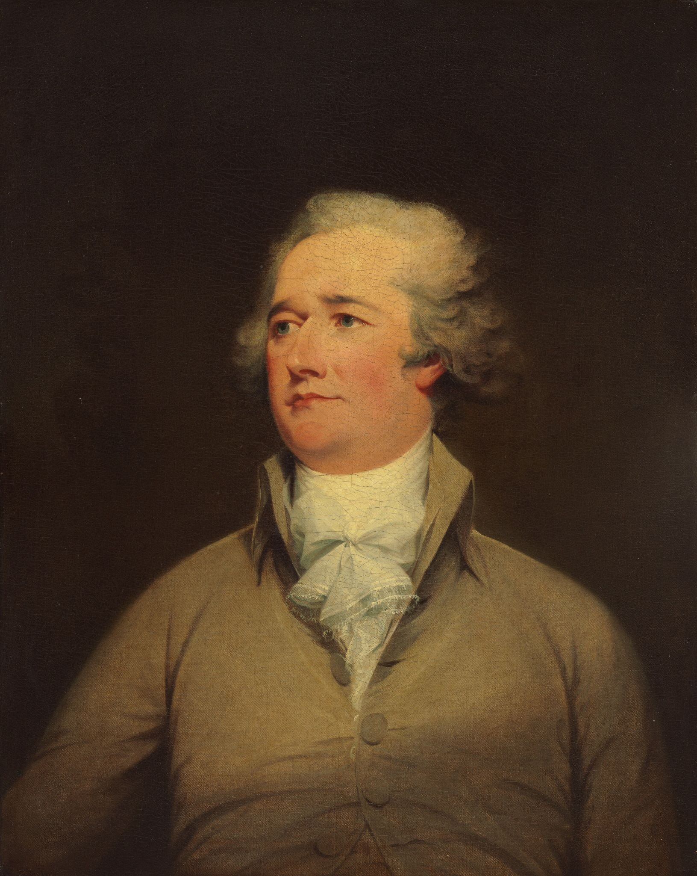
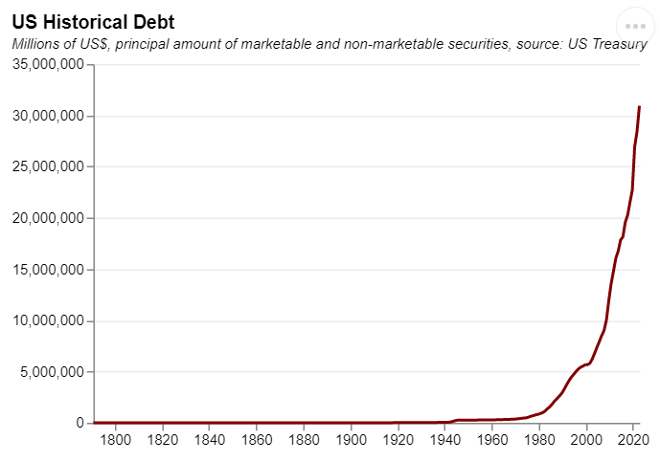
US Debt – history And some important history
Early US debt
Continental Congress borrows to fight revolutionary war. (Townshend Acts)
First Federal Debt is issued.
First Debt Crisis: The Wall St Panic.
1835. US debt completely paid off, briefly.
Alexander Hamilton (1755/1757 – 1804)
Notes:
https://history.state.gov/milestones/1784-1800/loans
https://raw.githubusercontent.com/RDeconomist/RDeconomist.github.io/main/charts/e4e/ch6_Government/historicalUSDebt.csv

Slide 31
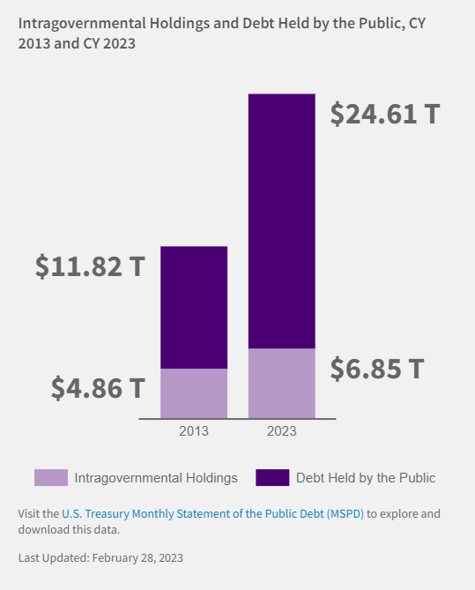
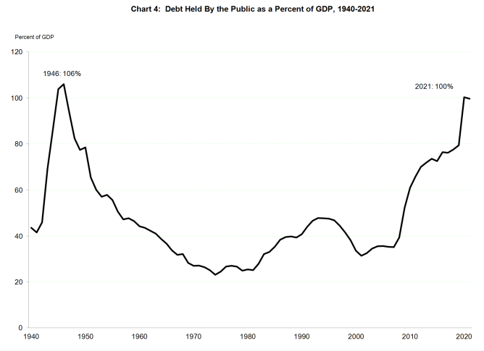
US Debt – recent growth Historically high debt
US Treasury Summary
US Treasury, Fiscal Report
Notes:
https://fiscaldata.treasury.gov/americas-finance-guide/national-debt/#breaking-down-the-debt
https://fiscaldata.treasury.gov/static-data/published-reports/frusg/FRUSG_2021.pdf

Slide 32
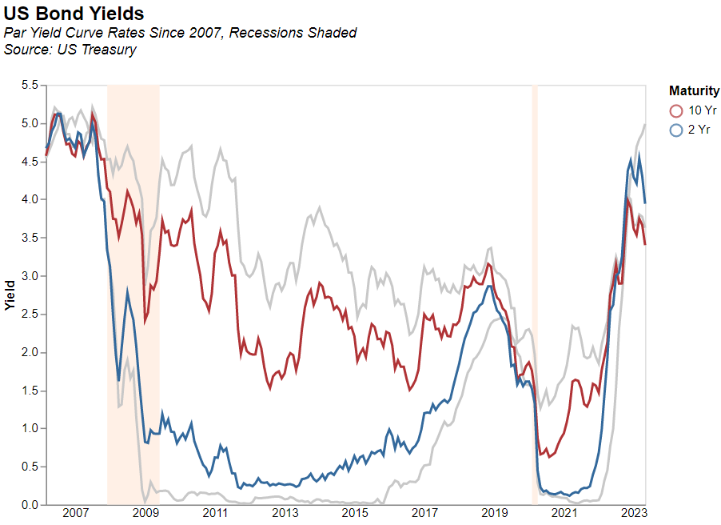
US Debt – how much does it cost? Rising interest rates in recent years
Notes:
https://home.treasury.gov/resource-center/data-chart-center/interest-rates/TextView?type=daily_treasury_yield_curve&field_tdr_date_value=2023
https://home.treasury.gov/policy-issues/financing-the-government/interest-rate-statistics

Slide 33
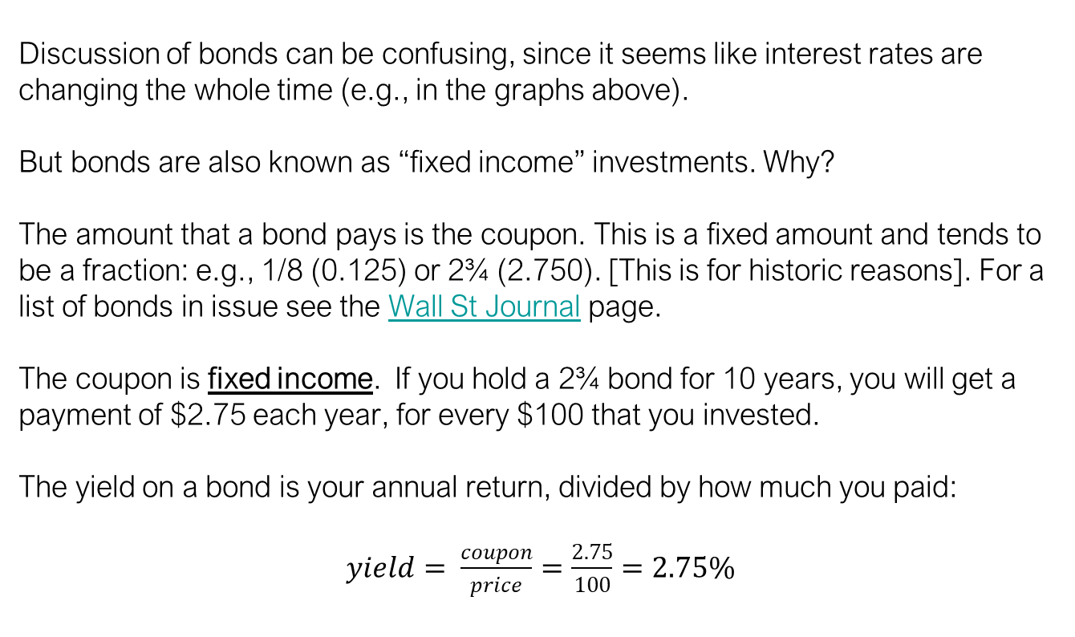
Bond logic: fixed income, flexible price Coupons, yields and prices
Discussion of bonds can be confusing, since it seems like interest rates are changing the whole time (e.g., in the graphs above).
But bonds are also known as “fixed income” investments. Why?
The amount that a bond pays is the coupon. This is a fixed amount and tends to be a fraction: e.g., 1/8 (0.125) or 2¾ (2.750). [This is for historic reasons]. For a list of bonds in issue see the Wall St Journal page.
The coupon is fixed income. If you hold a 2¾ bond for 10 years, you will get a payment of $2.75 each year, for every $100 that you invested.
The yield on a bond is your annual return, divided by how much you paid:
$yield= \frac{coupon}{price}=\frac{2.75}{100}=2.75\%$
Notes:
https://home.treasury.gov/resource-center/data-chart-center/interest-rates/TextView?type=daily_treasury_yield_curve&field_tdr_date_value=2023
https://home.treasury.gov/policy-issues/financing-the-government/interest-rate-statistics

Slide 34
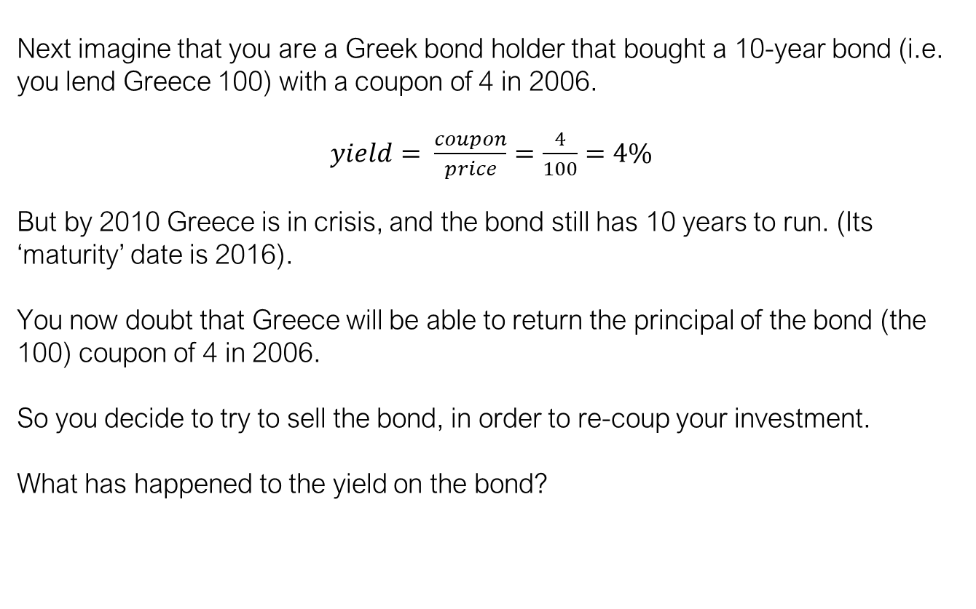
Bond logic: what happens when risk rises? Greece example…
Next imagine that you are a Greek bond holder that bought a 10-year bond (i.e. you lend Greece 100) with a coupon of 4 in 2006.
$yield= \frac{coupon}{price}=\frac{4}{100}=4\%$
But by 2010 Greece is in crisis, and the bond still has 10 years to run. (Its ‘maturity’ date is 2016).
You now doubt that Greece will be able to return the principal of the bond (the 100) coupon of 4 in 2006.
So you decide to try to sell the bond, in order to re-coup your investment.
What has happened to the yield on the bond?
Notes:
https://home.treasury.gov/resource-center/data-chart-center/interest-rates/TextView?type=daily_treasury_yield_curve&field_tdr_date_value=2023
https://home.treasury.gov/policy-issues/financing-the-government/interest-rate-statistics

Slide 35
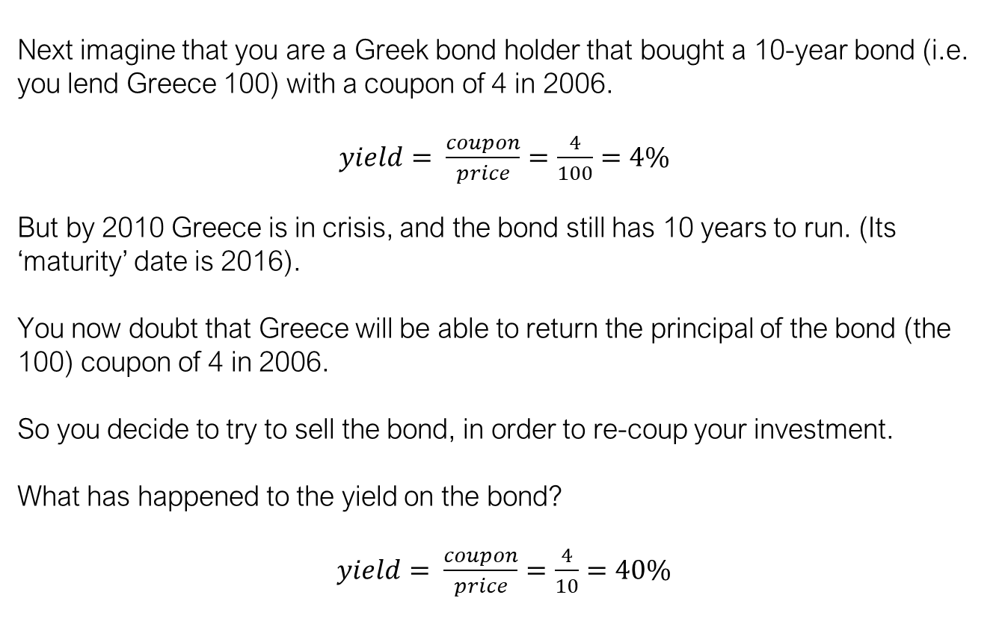
Bond logic: what happens when risk rises? Greece example…
Next imagine that you are a Greek bond holder that bought a 10-year bond (i.e. you lend Greece 100) with a coupon of 4 in 2006.
$yield= \frac{coupon}{price}=\frac{4}{100}=4\%$
But by 2010 Greece is in crisis, and the bond still has 10 years to run. (Its ‘maturity’ date is 2016).
You now doubt that Greece will be able to return the principal of the bond (the 100) coupon of 4 in 2006.
So you decide to try to sell the bond, in order to re-coup your investment.
What has happened to the yield on the bond?
$yield= \frac{coupon}{price}=\frac{4}{10}=40\%$
Notes:
https://home.treasury.gov/resource-center/data-chart-center/interest-rates/TextView?type=daily_treasury_yield_curve&field_tdr_date_value=2023
https://home.treasury.gov/policy-issues/financing-the-government/interest-rate-statistics

Slide 36
Bond logic – yield and duration The yield curve
Now suppose that a government offers 1 year, 5 year and 10-year bonds. These all have a coupon of 4. You want to invest for 10 years, so have 3 options:
Notes:
https://home.treasury.gov/resource-center/data-chart-center/interest-rates/TextView?type=daily_treasury_yield_curve&field_tdr_date_value=2023
https://home.treasury.gov/policy-issues/financing-the-government/interest-rate-statistics

Slide 37
Bond logic – yield and duration The yield curve
Now suppose that a government offers 1 year, 5 year and 10-year bonds. These all have a coupon of 4. You want to invest for 10 years, so have 3 options:
10-year bond. You buy in year 1, and get $5 per year, each year until year 10, when you get your 5 plus your initial investment of $100 back.
5-year bond. You buy in year 1 and get $5 back each year until year 5 when you get 100 back. That year you re-invest in another 5-year bond, which takes you out to year 10.
1-year bond. You get paid $5 each year and $100 at the end. You re-invest, and repeat this 10 times.
Notes:
https://home.treasury.gov/resource-center/data-chart-center/interest-rates/TextView?type=daily_treasury_yield_curve&field_tdr_date_value=2023
https://home.treasury.gov/policy-issues/financing-the-government/interest-rate-statistics

Slide 38
Bond logic – yield and duration The yield curve
Now suppose that a government offers 1 year, 5 year and 10-year bonds. These all have a coupon of 4. You want to invest for 10 years, so have 3 options:
What price would these bonds be?
Would you pay more, or less, for a 10-year $5 coupon bond or a 1-year $5 coupon bond?
Notes:
https://home.treasury.gov/resource-center/data-chart-center/interest-rates/TextView?type=daily_treasury_yield_curve&field_tdr_date_value=2023
https://home.treasury.gov/policy-issues/financing-the-government/interest-rate-statistics

Slide 39
Bond logic – yield and duration The yield curve
Locking your money up for a long time is a big decision.
There are costs in terms of:
Credit/default risk. You can tell right now how well a country (or company, in the case of corporate bonds) is doing. But can you tell in 2023, how well they will be doing in 2033.
Liquidity. Your money is committed for a full 10 years. You could sell the bond early but this is costly (most bonds are held to maturity). You can tell in 2023 you have $1m to invest, but can you really predict your cash (liquidity) needs in 2033?
Choice. With the 1-year option you get lots of staging posts along the way, where you can make a choice. There is some ‘option value’ here.
For these reasons the “normal” relationship is for longer-maturity bonds to have a lower price (higher yield) than short-duration bonds with the same coupon.
Notes:
https://home.treasury.gov/resource-center/data-chart-center/interest-rates/TextView?type=daily_treasury_yield_curve&field_tdr_date_value=2023
https://home.treasury.gov/policy-issues/financing-the-government/interest-rate-statistics

Slide 40
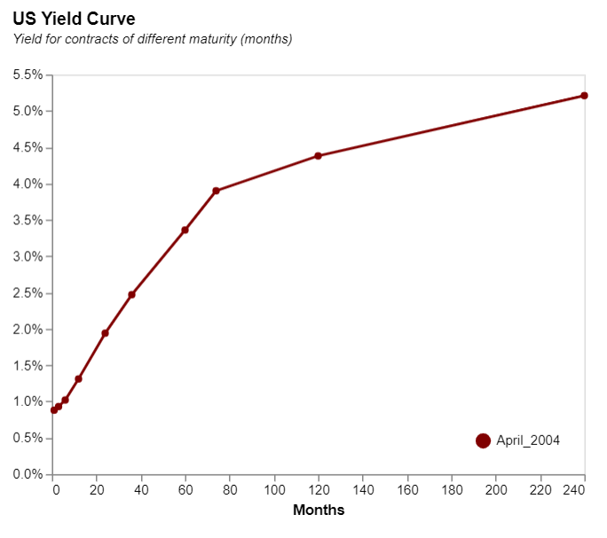
US Debt – cost vs duration The yield curve
Notes:
https://home.treasury.gov/resource-center/data-chart-center/interest-rates/TextView?type=daily_treasury_yield_curve&field_tdr_date_value=2023
https://home.treasury.gov/policy-issues/financing-the-government/interest-rate-statistics

Slide 41
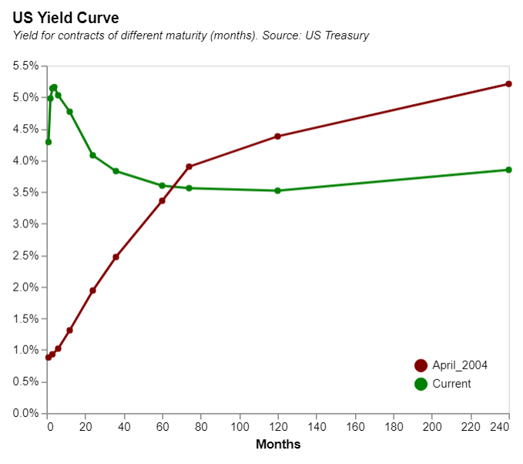
April 2023 – a historic moment… The US yield curve is currently “inverted”
Why might this be a warning sign for the US economy?
The yield curve is ‘inverted’…
Notes:
https://home.treasury.gov/resource-center/data-chart-center/interest-rates/TextView?type=daily_treasury_yield_curve&field_tdr_date_value=2023
https://home.treasury.gov/policy-issues/financing-the-government/interest-rate-statistics

Slide 42
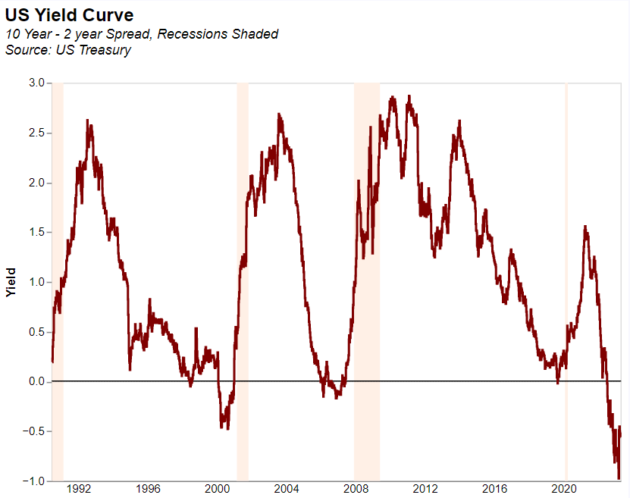
US Debt – 10y vs 2y The ‘yield spread’ – i.e. how steep is the yield curve?
Notes:
https://home.treasury.gov/resource-center/data-chart-center/interest-rates/TextView?type=daily_treasury_yield_curve&field_tdr_date_value=2023
https://home.treasury.gov/policy-issues/financing-the-government/interest-rate-statistics

Slide 43
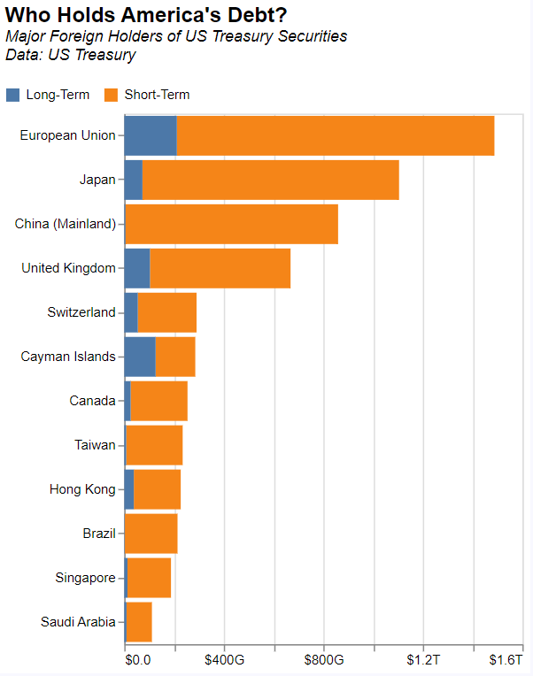
US Debt – who holds it? US Debt – domestic and foreign ownership
The US Treasury carefully tracks who holds its debt.
This is the so called “TIC” data (here)
Notes:
https://ticdata.treasury.gov/Publish/mfh.txt

Slide 44
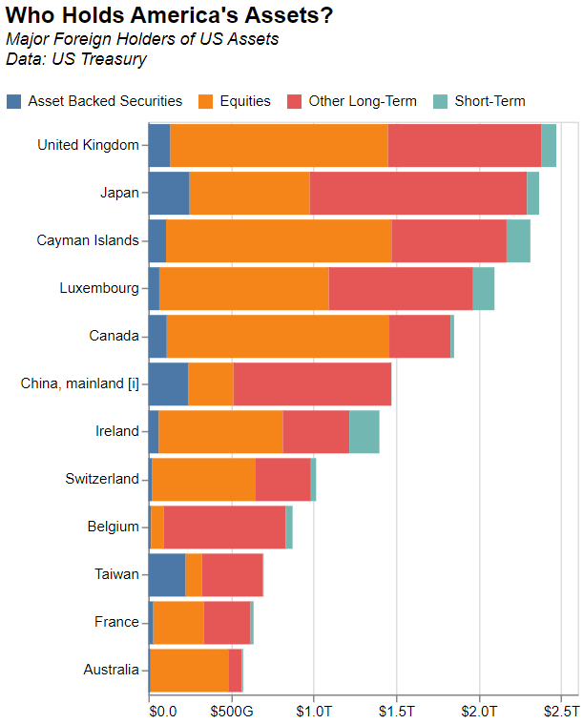
US assets – who holds them? Adding equity to the analysis above
Notes:
https://home.treasury.gov/news/press-releases/jy1311

Slide 45
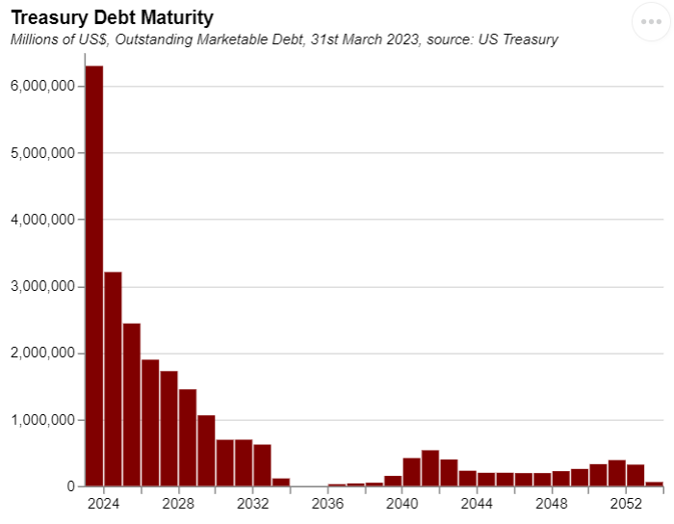
US Debt – when is it due? US Debt by maturity
Notes:
https://www.mercatus.org/media/51041/download#:~:text=State%20debt%20is%20calculated%20from,of%20state%20total%20personal%20income.

Slide 46
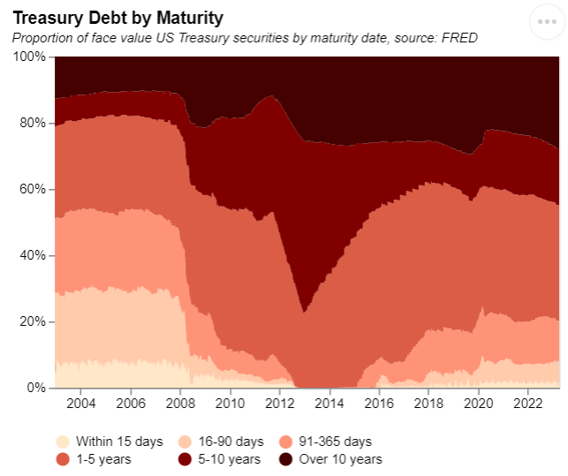
US Debt – changing maturity structure More LT debt
Notes:
https://www.mercatus.org/media/51041/download#:~:text=State%20debt%20is%20calculated%20from,of%20state%20total%20personal%20income.

Slide 47
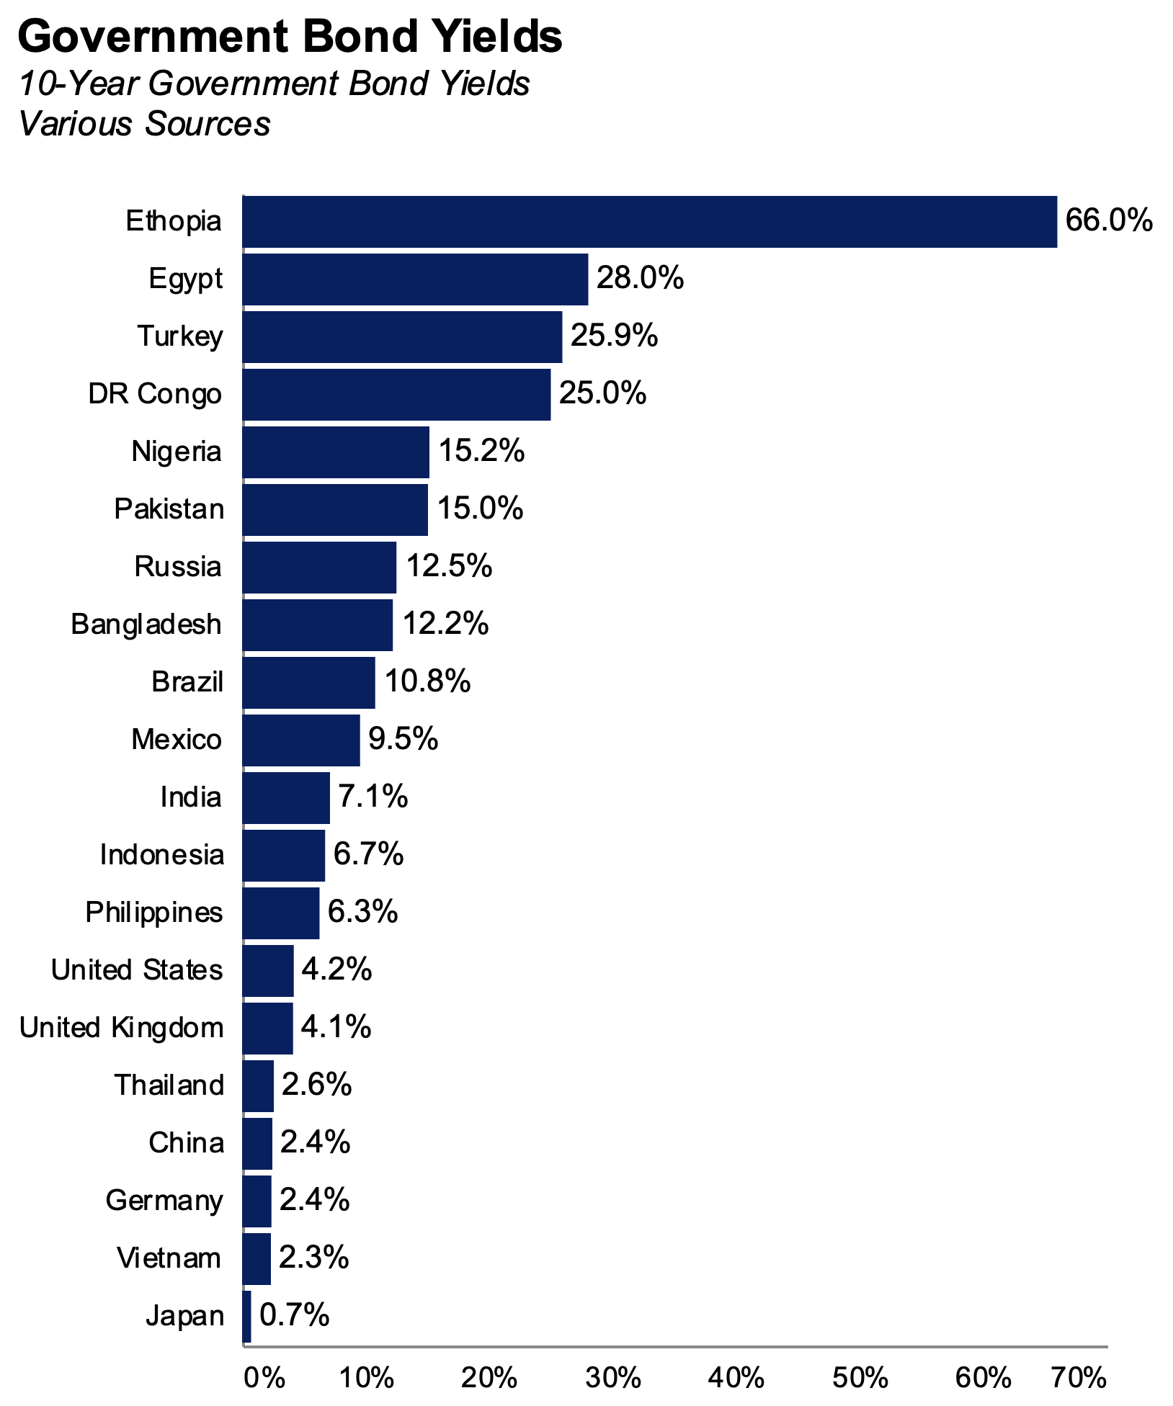
Debt costs: high and low Bond yields for a selected group of countries

Slide 48
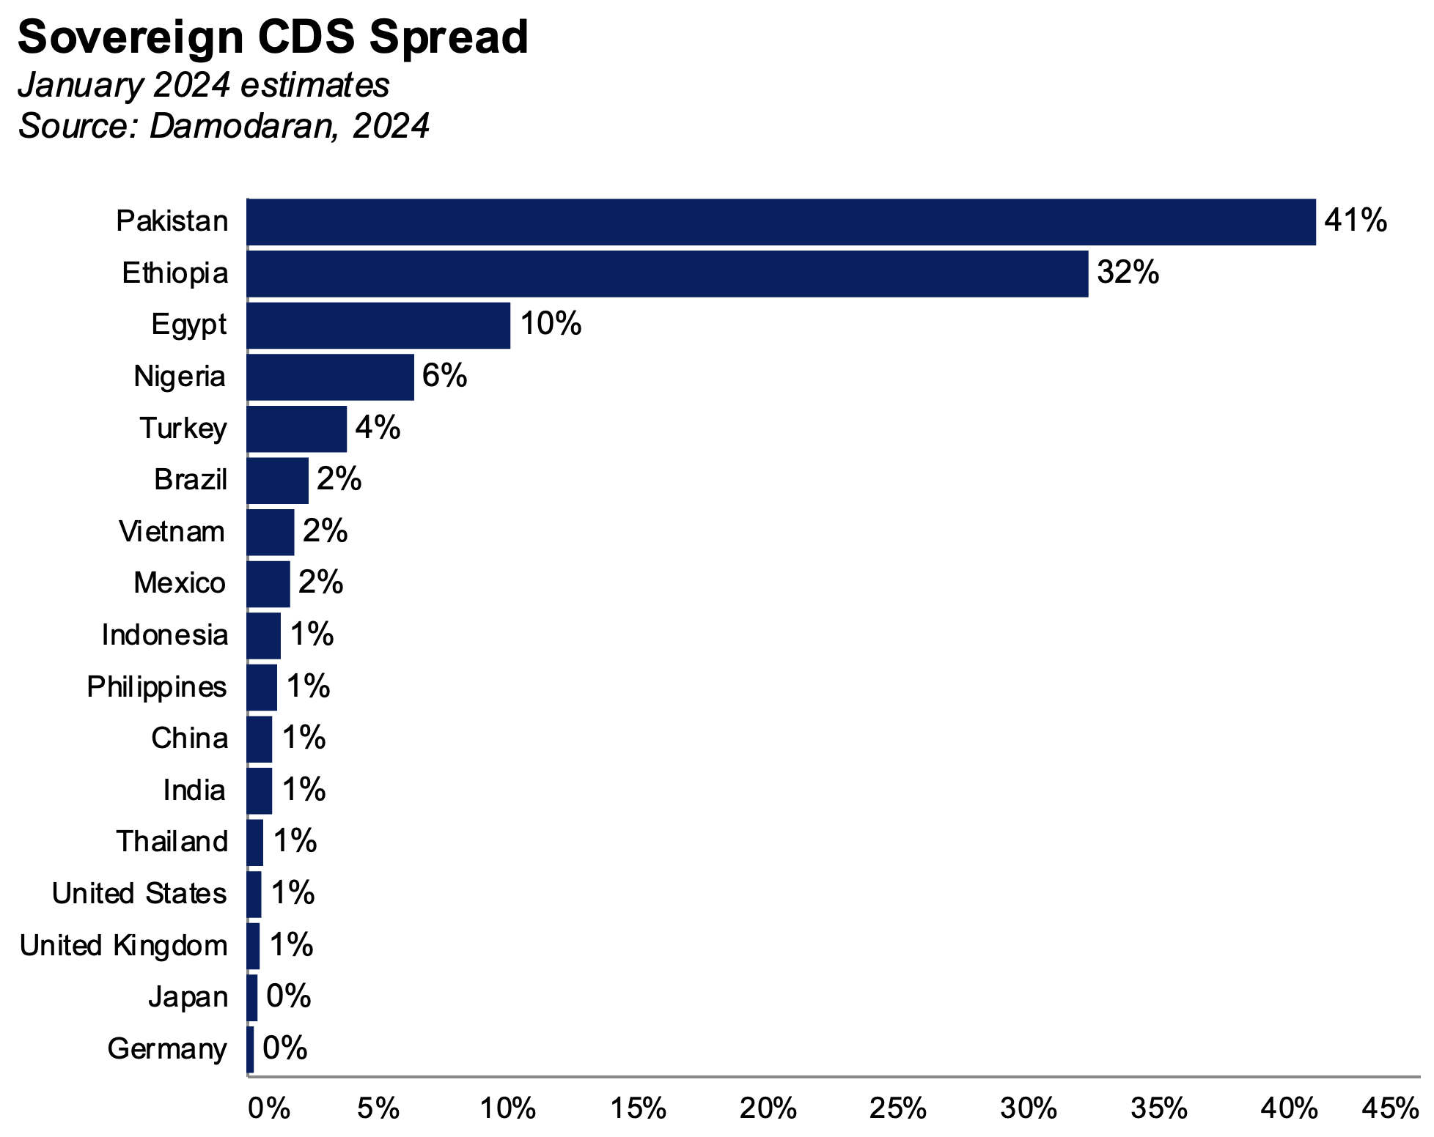
Debt costs: Credit Default Swaps Sovereign CDS Spreads

Slide 49
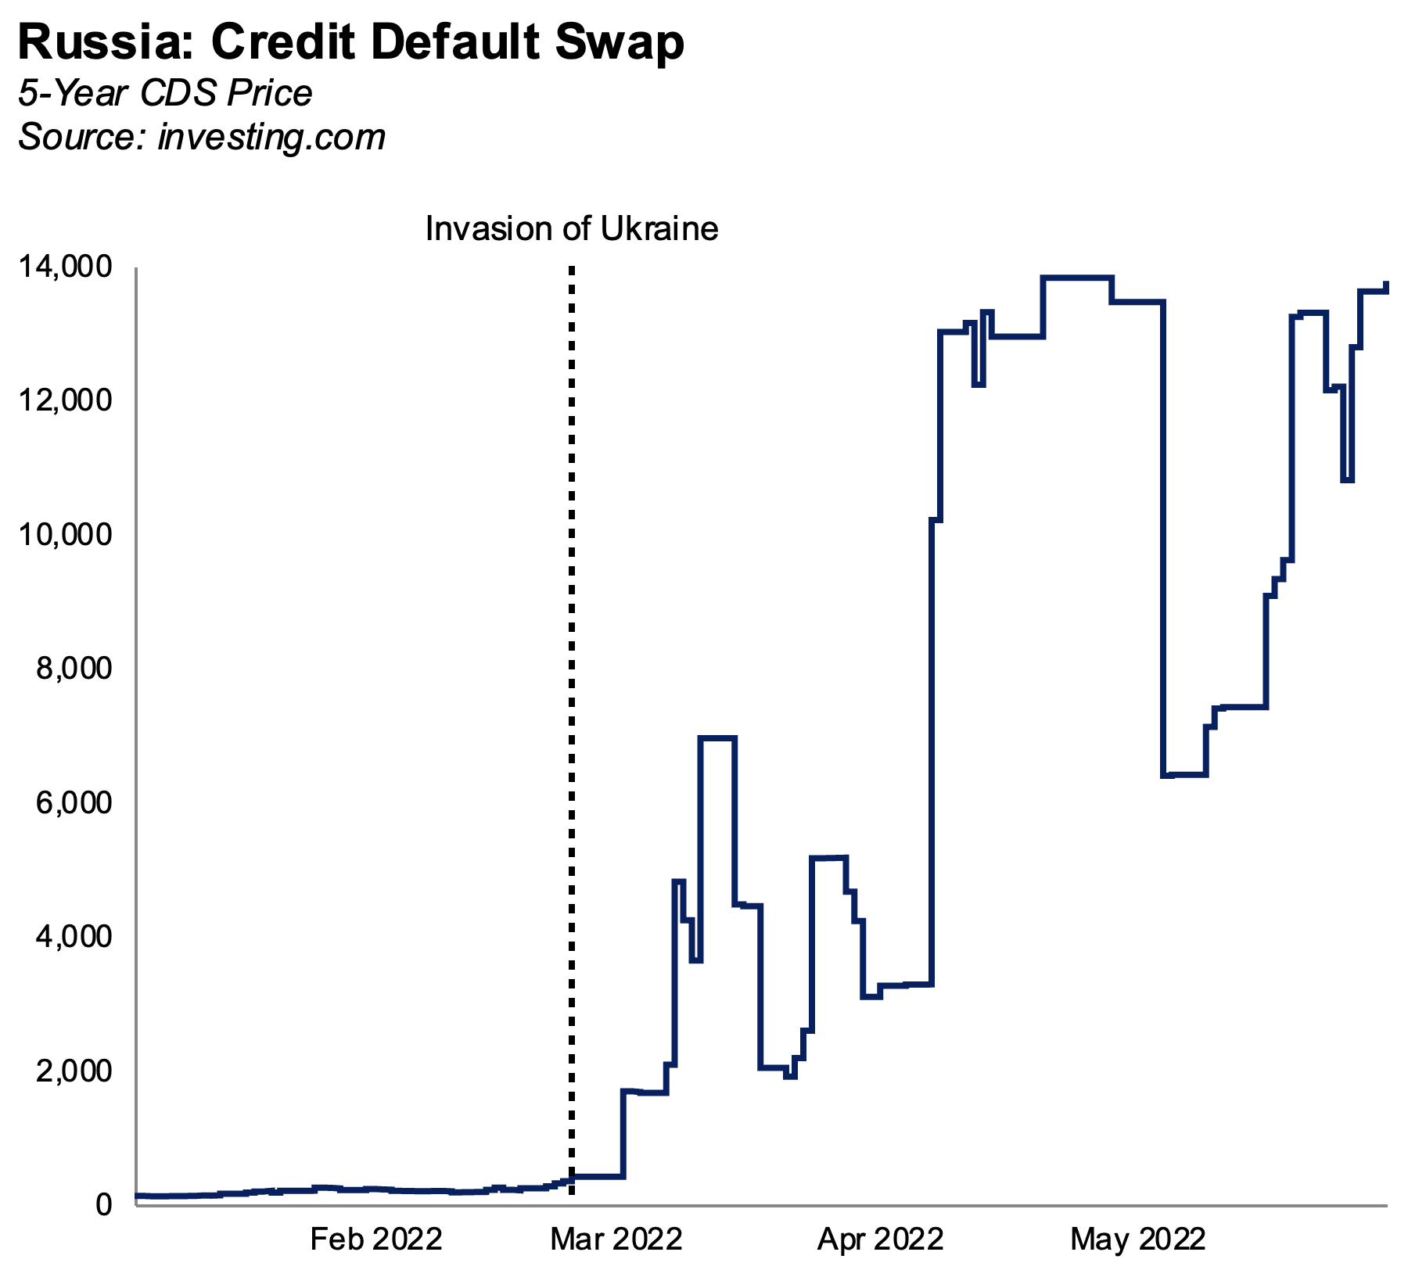
Debt costs: Credit Default Swaps Russian CDS and the war in Ukraine

Slide 50
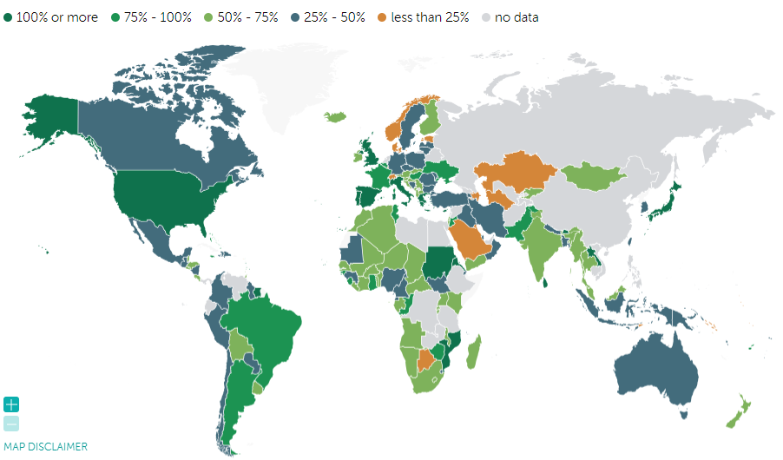
Debt outstanding Who are the world’s greatest debtors?
https://www.imf.org/external/datamapper/CG_DEBT_GDP@GDD

Slide 51
Debt sustainability
How much is too much?

Slide 52
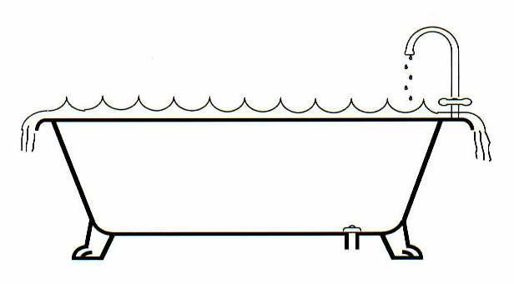
Debt sustainability Intuition: think of a bath at risk of flowing over
Factors to consider:
Existing debt
Deficit
GDP growth
Inflation
Remittances
International reserves
Institutions
Notes:
https://www.mercatus.org/media/51041/download#:~:text=State%20debt%20is%20calculated%20from,of%20state%20total%20personal%20income.

Slide 53
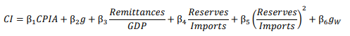
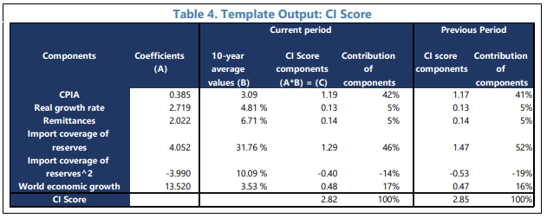
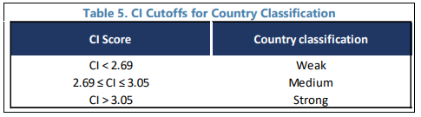
Sustainability analysis How the IMF does it
The IMF-WB use the following formula:
The CPIA is the World Bank’s Country Policy and Institutional Assessment (CPIA) score
IMF paper
Notes:
https://www.mercatus.org/media/51041/download#:~:text=State%20debt%20is%20calculated%20from,of%20state%20total%20personal%20income.

Slide 54
Current risks Countries that are a concern
Official analysis:
The WB publishes its analysis: https://www.worldbank.org/en/programs/debt-toolkit/dsa
Some countries as seen as a risk:
Report on Egypt for example
Others are currently in default / in a crisis:
Report on Sudan
Debt campaigns:
https://debtjustice.org.uk/countries-in-crisis
Notes:
https://www.mercatus.org/media/51041/download#:~:text=State%20debt%20is%20calculated%20from,of%20state%20total%20personal%20income.

Slide 55
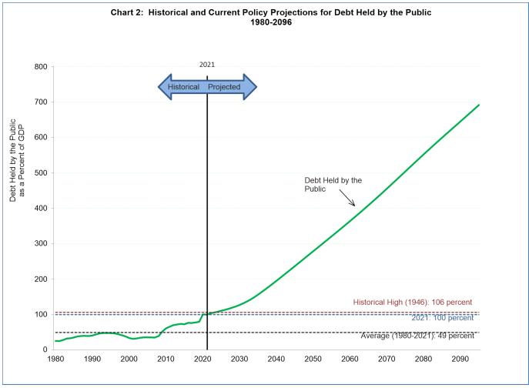
Sustainability: US projections The US Treasury’s worrying analysis
Notes:
https://www.mercatus.org/media/51041/download#:~:text=State%20debt%20is%20calculated%20from,of%20state%20total%20personal%20income.

Slide 56
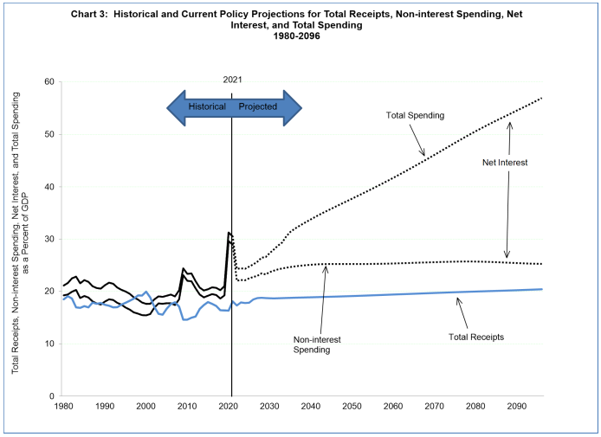
Sustainability: US projections The US Treasury’s worrying analysis
Notes:
https://www.mercatus.org/media/51041/download#:~:text=State%20debt%20is%20calculated%20from,of%20state%20total%20personal%20income.

Slide 57
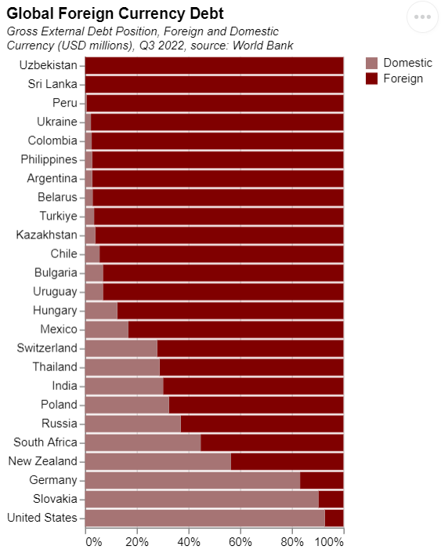
Your currency or mine? Is FX debt a good idea, or a huge risk?
FX denominated debt
Many countries do not borrow in their own currency, but rather in the currency of another country.
Why?
Cost (mkt size)
Liquidity
Credibility
Discuss:
What are the risks here?
Notes:
https://databank.worldbank.org/data/embed-int/Table-2-SDDS-new/id/7857d781

Slide 58
Major debt crises Mexico, the Asian Financial Crisis, Russia.
EME debt crises were a major theme 25 years ago.
Many of them were in our P20 group of big countries, and shaped those economies:
1994 – Mexico. (Martinez, 1998). Impact on Brazil.
1997 – Thailand. (Fischer, 1988).
1998 – Indonesia and S Korea. (IMF, 2022)
1998 – Russia. (Coyle, 2022).
Discuss:
Fixed exchange rates and FX debt.
What happens following a devaluation?
Notes:
https://www.mercatus.org/media/51041/download#:~:text=State%20debt%20is%20calculated%20from,of%20state%20total%20personal%20income.

Slide 59
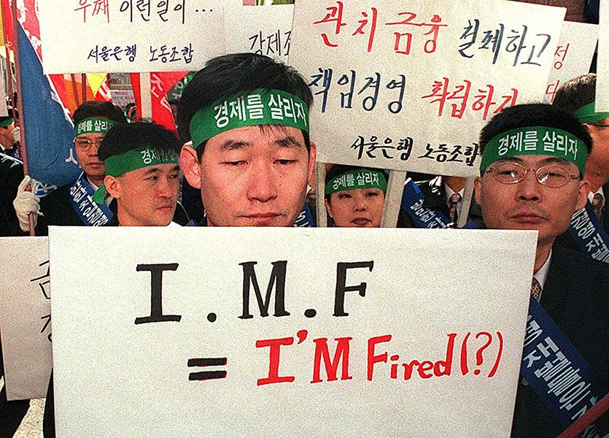
IMF loans and conditionality After a crisis countries receive IMF loans, but these come with conditions.
Reflections on the role of the IMF. (Wellisz, 2022)
Notes:
https://www.mercatus.org/media/51041/download#:~:text=State%20debt%20is%20calculated%20from,of%20state%20total%20personal%20income.

Slide 60
Debt sustainability
Example: Illinois

Slide 61
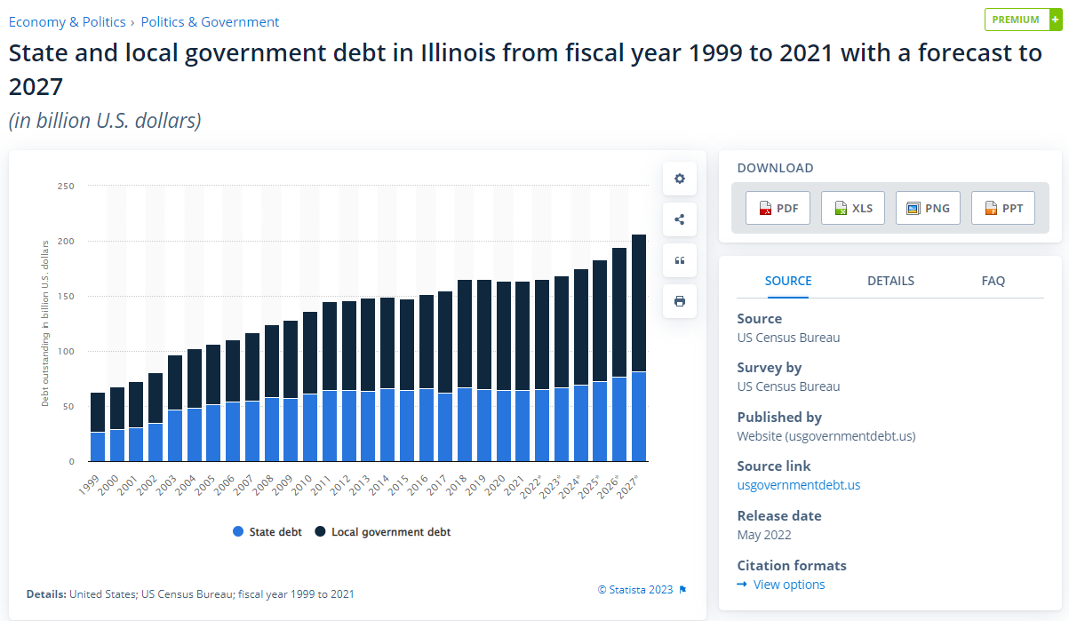
Illinois: debts Is debt rising uncontrollably?
Notes:
https://www.mercatus.org/media/51041/download#:~:text=State%20debt%20is%20calculated%20from,of%20state%20total%20personal%20income.

Slide 62



Illinois: affordability Compare debt payments with an economic measure
Remember: beware nominal or money-terms analysis. Compare your state’s budget with some measure of economic strength.
Illinois uses three such measures in its analysis: personal income, head count, state income.
Notes:
https://www.mercatus.org/media/51041/download#:~:text=State%20debt%20is%20calculated%20from,of%20state%20total%20personal%20income.

Slide 63

Illinois: ratings What do the ratings agencies think?
State Budget, page 557
Notes:
https://www.mercatus.org/media/51041/download#:~:text=State%20debt%20is%20calculated%20from,of%20state%20total%20personal%20income.

Slide 64
Illinois: concerns What is the plan for state pensions?
This would be my concern for Illinois:
State pensions are a large chunk of the budget.
Headcount is rising. So the number of people with future pension claims is rising.
My question: How are pension payments funded? What are the options?
Notes:
https://www.mercatus.org/media/51041/download#:~:text=State%20debt%20is%20calculated%20from,of%20state%20total%20personal%20income.

Slide 65
Illinois: concerns What is the plan for state pensions?
This would be my concern for Illinois:
State pensions are a large chunk of the budget.
Headcount is rising. So the number of people with future pension claims is rising.
My question: How are pension payments funded? What are the options?
From existing pensioners historic savings?
Funded. This type of pensions is financed from the contributions that pensioners themselves made when they were working.
Notes:
https://www.mercatus.org/media/51041/download#:~:text=State%20debt%20is%20calculated%20from,of%20state%20total%20personal%20income.

Slide 66
Illinois: concerns What is the plan for state pensions?
This would be my concern for Illinois:
State pensions are a large chunk of the budget.
Headcount is rising. So the number of people with future pension claims is rising.
My question: How are pension payments funded? What are the options?
From existing pensioners historic savings?
Funded. This type of pensions is financed from the contributions that pensioners themselves made when they were working.
From current workers pension payments made today?
Pay-as-you-go or “unfunded”. Most public pension systems operate in this way. Pensions paid to current pensioners are financed from contributions paid by current workers.
Notes:
https://www.mercatus.org/media/51041/download#:~:text=State%20debt%20is%20calculated%20from,of%20state%20total%20personal%20income.

Slide 67
Illinois: concerns What is the plan for state pensions?
This would be my concern for Illinois:
State pensions are a large chunk of the budget.
Headcount is rising. So the number of people with future pension claims is rising.
My question: How are pension payments funded? What are the options?
From existing pensioners historic savings?
Funded. This type of pensions is financed from the contributions that pensioners themselves made when they were working.
From current workers pension payments made today?
Pay-as-you-go or “unfunded”. Most public pension systems operate in this way. Pensions paid to current pensioners are financed from contributions paid by current workers.
From future workers tax payments?
Pension debt. This is what Illinois is doing. Issuing debt today, that will be paid back in the distant future, to pay its existing pensioners.
Notes:
https://www.mercatus.org/media/51041/download#:~:text=State%20debt%20is%20calculated%20from,of%20state%20total%20personal%20income.

Slide 68
Illinois: concerns What is the plan for state pensions?
This would be my concern for Illinois:
State pensions are a large chunk of the budget.
Headcount is rising. So the number of people with future pension claims is rising.
My question: How are pension payments funded? What are the options?
Funding today from the past.
Funding today from today.
Funding today from the future.
Is this sustainable? Not clear. Will depend on future growth and demographics.
Notes:
https://www.mercatus.org/media/51041/download#:~:text=State%20debt%20is%20calculated%20from,of%20state%20total%20personal%20income.

Slide 69

Break

Slide 70
Economics for Public Policy
LECTURE 11.
GOVERNMENT 1 – SPENDING AND DEBT
Richard Davies
Winter Term, 2024

Slide 71
Macro menu Where we’ve been, and where we are heading….
Previously:
GDP and Visualisation
Growth and Recessions
Jobs and Wages
Currencies and Inflation
Market Crashes and Bank Runs
Spending
Today: Tax
Facts: taxation
What are the big taxes and how much do they raise?
Tax troubles
Distortions and how to design a good tax.
Shaping behaviour
Taxes that are designed to distort
Spending and saving
Theory and facts
Tax and the cycle
How tax stimulus works, and how it doesn’t
Next: Trade
Then: Long-term trends
Notes:
Class discussion

Slide 72
Motivation
Tax Facts

Slide 73

Is America paying more tax? On a long-run view: yes, much more
Notes:
Class discussion

Slide 74

Is America paying more tax? Post-WW2 US tax take is 15-17% most years.
Notes:
Class discussion

Slide 75

Tax revenue by country How much tax revenue do big countries take?
Notes:
https://data.worldbank.org/indicator/GC.TAX.TOTL.GD.ZS?end=2020&locations=GB-US-ID-BR-RU-VN-BD-PK-IN-DE-CN-MX-TH-JP&start=2020&view=bar

Slide 76

Consumption taxes VAT / sales taxes globally
Notes:
Class discussion

Slide 77

Chicago State taxes in Chicago, and how much they generate
Notes:
Class discussion

Slide 78
Principles of Taxation
What makes a good tax? Are all taxes bad?

Slide 79
Distorted signals – taxes vs prices Information and the market economy
Prices are vital in markets. Economists think of them as “signals”. Data messages that both reflect and guide decisions made by consumers and producers.
Taxes are a disruption to these signals. They driving a wedge between the price paid by the buyer and the price received by the seller.
Income tax means that an employer pays more for an hour of work than the employee receives for it.
Sales taxes (like VAT) means that a retailer receives less for a product she sells than her customer pays for it.
These wedges can change—distort—decisions.
Notes:
Class discussion

Slide 80

Taxes change choices What is going on here?
Notes:
Class discussion

Slide 81

Adam Smith How to set a good tax - four cannons of taxation
(i) The subjects of every state ought to contribute towards the support of the government, as nearly as possible, in proportion to their respective abilities ...
(ii) The tax which the individual is bound to pay ought to be certain and not arbitrary ...
(iii) Every tax ought to be levied at the time, or in the manner, in which it is most likely to be convenient for the contributor to pay it.
(iv) Every tax ought to be so contrived as to take out of the pockets as little as possible, over and above that which it brings into the public treasury of the state.
Adam Smith, The Wealth of Nations. 1776.
Adam Smith (1723-1790)
Notes:
Class discussion

Slide 82

Frank Ramsey Pioneering work in philosophy and economics
A true polymath who died, unexpectedly, in his 20s.
Influenced some of the greatest minds of C20th inc Ludwig Wittgenstein.
1927. A Contribution to the Theory of Taxation.
Q. Given that taxes are distortionary, what is the best way of raising revenues?
A. Set them so that the consumption of each good is reduced proportionately*
Frank Ramsey (1903-1930)
Notes:
Class discussion

Slide 83
Frank Ramsey Pioneering work in philosophy and economics
Intuition. Ramsey’s paper rejects the simple common sense idea that raise tax on one good.
Instead spread the tax so that there are lots of individually tailored taxes, set in proportion to how much demand for the good changes with the tax.
Far more sophisticated than prevailing view. But (my critique) how feasible? In practical terms how good are governments at setting and collecting taxes?
Resources:
Biography (Stanford) here.
Paper: Stiglitz (EJ, 2015).
Radio – Better than the Stars – BBC, 1978.
Frank Ramsey (1903-1930)
Notes:
Class discussion

Slide 84


Arnold Harberger And his famous triangles – the graphical analysis of deadweight loss
Arnold Harberger
https://www.nber.org/system/files/working_papers/w6852/w6852.pdf
Notes:
Class discussion

Slide 85
James Mirrlees Tax by Design
Developed Ramsey’s work. [e.g. Mirrlees (1971)]. Wrote influential (and readable) 2011 book that discussed taxation in detail. Principles:
negative effects of the tax system on welfare and economic efficiency— they should be minimized;
administration and compliance costs—all things equal, a system that costs less to operate is preferable;
fairness other than in the distributional sense—for example, fairness of procedure, avoidance of discrimination, and fairness with respect to legitimate expectations;
transparency—a tax system that people can understand is preferable to one that taxes by ‘stealth’
https://ifs.org.uk/books/tax-design
Notes:
https://ifs.org.uk/sites/default/files/output_url_files/taxbydesign.pdf

Slide 86
The Mirlees Review – three simple rules Tax by design
More simply, taxation should be:
Simple
Neutral
Stable
It is often:
Complex
Non-neutral
Frequently changing
https://ifs.org.uk/books/tax-design
Notes:
Class discussion

Slide 87
How to minimize distortions Tax something that cannot be adjusted
Recall the tax problem. Prices are signals, and taxes change those signals. You want to tax something—work for example—but then people start doing less of that thing. How can this be avoided?
One answer is to tax things that cannot or will not be adjusted. Examples:
Lump-sum tax. Linked to something people cannot adjust or alter: age, say. So everyone who is 30-40, for example, would have to pay $X. Feasible but politically unattractive, since no link between tax and ability to pay.
Tax on rents. “Rents” to an economist are ‘excess returns’ over the next-best use of an input. If only this excess is taxed, then it should not distort decisions.
Land tax. Location, location, location. This is the source of economic value and cannot be changed: you cannot move your land elsewhere.
Notes:
Class discussion

Slide 88

Poll Tax The community charge: public reaction to a lump sum tax.
Trafalgar Square, 1990.
Notes:
Class discussion

Slide 89
Two concerns: efficiency & distribution The poll tax as an extreme case of an important trade off
Discuss:
Efficiency
Distribution
How is this trade off in your state / country?
Notes:
Class discussion

Slide 90
Predicting the impact of a tax Two competing effects
Taxes alter prices. Price changes, as we previously learned, often have two competing effects. Take the case of a tax on earnings. This changes wages, reducing the wage that workers earn.
Income received for a given number of hours of work is now lower. This encourages workers to work more to offset the decline in living standards. The income effect.
An hour of work is also now less attractive relative to an hour of leisure than previously. To put it another way, choosing leisure has become cheaper in terms of the ‘cost’ of lost pay. This encourage people to work less and take more leisure. The substitution effect.
Notes:
Class discussion

Slide 91

The Laffer Curve How much revenue can a tax raise?
https://www.nytimes.com/2017/04/25/us/politics/white-house-economic-policy-arthur-laffer.html
Notes:
Class discussion

Slide 92
The Laffer Curve How much revenue can a tax raise?
Decreasing in the tax rate
Notes:
Ask class: would an increase the tax rate increase or reduce tax revenue?

Slide 93

The Laffer Curve How much revenue can a tax raise?
Decreasing in the tax rate
Increasing the tax rate can increase or decrease total tax revenue, depending on which side of the Laffer Curve you are on

Slide 94
(in)famous taxes Some interesting taxes and their results
1100. England. “Scutage”. The ‘cowards’ tax.
1341. France. The “Gabelle”. A salt tax. Role in Revolution (1789)
1705. Russia. Peter the Great. Tax on Beards.
UK taxes with Laffer-type responses:
1696. Windows.
1784. Hats.
1789. Candles.
1794. Wig Perfume.
Notes:
https://en.wikipedia.org/wiki/Gabelle.
https://www.independent.co.uk/news/world/watered-whisky-dilutes-free-trade-tax-break-for-japan-s-distillers-upsets-ec-1458248.html

Slide 95
Modern distortions How taxes shape the modern economy
Discussion:
Big policy questions and headaches for governments today.
Capital Structure. Debt vs Equity
Firm size. Income tax vs self-incorporation
Location. Base erosion / profit shifting (BEPS).
https://www.oecd.org/tax/beps/
Notes:
Class discussion

Slide 96



Noticed a lot of films based in Ireland recently? Big budget movies filmed in Aran, Achill, Dublin and Donegal,
Notes:
Class discussion

Slide 97
Tax credits Ireland’s “Section 481” Tax Credits for film companies
2022. €127.3m
2021. €137.1m
Notes:
Class discussion

Slide 98
Distortion by design
When is the distorting impact of taxes useful?

Slide 99
Fields, Forts and Lighthouses Problems with markets - history
William Foster Lloyd, Oxford lectures, 1832.
Political economist concerned about the rapid population growth.
Described public land on which farmers were free to graze their cattle on and observed that the common would end up “bare worn” from overgrazing, asking:
“Why are the cattle on a common so puny and stunted?”
Notes:
Class discussion

Slide 100
Fields, Forts and Lighthouses Problems with markets - history
William Foster Lloyd, Oxford lectures, 1832.
Political economist concerned about the rapid population growth.
Described public land on which farmers were free to graze their cattle on and observed that the common would end up “bare worn” from overgrazing, asking:
“Why are the cattle on a common so puny and stunted?”
Consider the farmer’s calculation:
Weighs the pros and cons of allowing extra cattle onto a field.
If the famer owns the land he will consider the full implications of his actions: he knows that each extra cow will eat more grass, taking this nourishment away from the rest of his herd. At some point the farmer knows the land is “saturated”, adding another beast to the herd makes all his others go hungry, the farmer imposes a cost on himself and seeks out another field.
Notes:
Class discussion

Slide 101
Fields, Forts and Lighthouses Problems with markets - history
William Foster Lloyd, Oxford lectures, 1832.
Political economist concerned about the rapid population growth.
Described public land on which farmers were free to graze their cattle on and observed that the common would end up “bare worn” from overgrazing, asking:
“Why are the cattle on a common so puny and stunted?”
Consider the farmer’s calculation:
Weighs the pros and cons of allowing extra cattle onto a field.
But on common ground the calculation changes: the downside of adding an extra animal doesn’t harm only the famer’s cattle, but every animal on the common, including those that he does not own. The famer ignores the costs he imposes on others—and each other farmer does the same—the land ends up over-grazed, the cattle under-nourished.
Notes:
Class discussion

Slide 102
Fields, Forts and Lighthouses Problems with markets - history
Foster Lloyd’s story built on by Cambridge economists, first Henry Sidgwick and later AC Pigou.
Sidgwick worried that a free market outcome would be out of line with what was best from a public perspective.
Considering a lighthouse:
“it may easily happen that the benefits of a well-placed lighthouse must be largely enjoyed by ships on which no toll could be conveniently imposed.”
The problem is that we might end up with too few valuable lighthouses, due to the lack of a way to determine a price and take a payment.
Notes:
Class discussion

Slide 103
Fields, Forests and Lighthouses Classic examples of externalities set out by Lloyd (1833), Sidgwick (1883) and Pigou (1920).
 | Problem | Result
Common ground | Farmer ignores the cost his cattle impose on other farmers | Too much grazing, land ends up depleted
Clear air | Industrialists and homeowners ignore the impact of their furnaces and fires | Too much smoke and smog, high costs of cleaning clothes.
Forests | Planter isn’t paid for the rain regulation that all gain from | Too little planting, too few trees
Lighthouses | Foreign ships gain from safe water but don’t contribute to funding | Too few lighthouses
Scientific research | Ideas can be quickly copied, so inventors do no enjoy the full gains | Too little research, too few scientific discoveries
Critique (Coase, 1974)
Notes:
Class discussion

Slide 104
Pigouvian Taxation Using a tax distortion to offset a problem
Problem in all these examples is a divergence between private costs/benefits, and society’s costs/benefits.
Some private actions, for example smoking, could impose a cost on others. This is referred to as a negative externality. The result is that we might end up with too much smoking.
The idea of Pigouvian Taxation is to use the distorting property of taxes to shape behaviour.
Charging a tax on cigarettes raises the private cost borne by the individual. This is likely to distort their decision—the smoke less—and in so doing, bring their decision in line with society’ optimal smoking level.
Notes:
Class discussion

Slide 105
Pigouvian Tax – the idea Using a tax distortion to offset a problem
Costs,
Benefits
My cost
My benefit
Amount of smoking
$$S_{1}$$
Notes:
Class discussion

Slide 106
Pigouvian Tax – the idea Using a tax distortion to offset a problem
Costs,
Benefits
Public cost
My cost
My benefit
$$X$$
Amount of smoking
$$S_{1}$$
Notes:
Class discussion

Slide 107
Pigouvian Tax – the idea Using a tax distortion to offset a problem
Costs,
Benefits
Public cost
My cost with a tax
My cost
My benefit
$$S_{2}$$
Amount of smoking
$$S_{1}$$
Notes:
Class discussion

Slide 108
“Sin” taxes Intentionally making certain actions costly
Examples include:
Tobacco and alcohol
Gambling
Sugar
Cannabis
Sin taxes in Texas: 7% of revenue.
Notes:
Class discussion

Slide 109
Stimulating the economy
Why MPCs matter for fiscal policy

Slide 110
The Marginal Propensity to Consume A relationship at the core of fiscal policy
If I give someone $500 to spend, what fraction of it would they spend?
Discuss considerations
Notes:
Class discussion

Slide 111
MPC - time and value How much will you spend
Time period matters
Presumably over the rest of your life (or your heirs’ lives) you would spend it all: so the MPC over your life is 100%.
Presumably in the next minute the MPC is close to 0.
We typically measure MPCs over one quarter or one year
Amount of money matters
MPC out of $10,000 probably smaller than MPC out of $1
MPCs typically refer to very small amounts, even though that is typically not what we measure in the data
Notes:
Ask, what MPC would be over remainder of life? And what about in the next instant?

Slide 112
The Euler Equation Deriving it by intuition
The equation is a theory of how we spend and save. How much will we save today in order that we can consume more tomorrow?
Households will try to balance out their saving and spending:
Spending today
Spending tomorrow

Slide 113
The Euler Equation Deriving it by intuition
If the benefits are not equal, then they can do better by adjusting their spending – either by saving more or less…
Spending tomorrow
Spending today

Slide 114
The Euler Equation What is the benefit of consuming today?
If the benefits are not equal, then they can do better by adjusting their spending – either by saving more or less…
The consumer is thinking about a small extra amount of consumption. This gives them some extra utility. The small amount of well-being is their marginal utility which they get today. Call this ${MU}_{today}$
What happens if they forgo this, saving the money until tomorrow?
Interest payment. They save by buying a bond, or putting the money in a bank. They get a payment ($r$) for this. So, the money they spend tomorrow is $(1+r)$.
Discounting. They care less about tomorrow than today, due to impatience. This is measured by a discount factor, $β$.
Consumption tomorrow. They get the marginal boost to their well being from consuming tomorrow: ${MU}_{today}$

Slide 115
The Euler Equation What is the benefit of consuming today?
Putting the parts together we get:
$${MU}_{today}=β\text{(1+}\text{r}\text{)}{MU}_{tomorrow}$$
$${MU}_{t}=β\text{(1+}\text{r}\text{)}{MU}_{t+1}$$
This is typically written as:
$$u^{′}{(c}_{t})=β\text{(1+}\text{r}\text{)}{E[u}^{′}{(c}_{t+1})]$$
Marginal value of spending
today
Marginal value of spending tomorrow
Impatience:
Prefer consuming today over tomorrow
Earn interest on savings

Slide 116
Back to spending The role of the government in the cycle
We have discussed the value of things that run counter to cycles in previous lectures. If you can find an asset that goes up when times are bad, this is very valuable. It helps smooth consumption.
The same idea holds in terms of the government. Two forms:
1. Automatic stabilizers. A number of payments “automatically” kick in during a downturn. Unemployment insurance.
2. Counter-cyclical spending. The idea that the government can time its investments in (roads, rail) and spend more when times are bad, less when times are good. This would offset the cycle somewhat.
Looking at it through the lens of GDP-E, the broad idea is to have C and G on a different cycle.

Slide 117
Stimulus spending Payments to households during recessions
The idea. Make a direct transfer of cash to households during a recession.
Is this GDP? No: it is a transfer.
But it might stimulate GDP, if the household spends.
Stimulus spending - 2008
Used by almost all major economies during 2008 recession
Large!! $96bn in 2008, equivalent to around 0.7% of annual GDP

Slide 118


Stimulus: 2020-2021 Economic Impact Payments
Notes:
https://www.pgpf.org/blog/2021/03/what-to-know-about-all-three-rounds-of-coronavirus-stimulus-checks

Slide 119
Stimulus payments: the idea Two motivations
1. Stimulus packages alleviate economic hardship.
2. They may boost the economy by raising aggregate spending/income (i.e., GDP)
The boost is due to an effect known as the Keynesian Multiplier.
Assume a government provides $100bn in stimulus checks, and households spend 25%.
Is the overall boost to GDP $25bn?
Notes:
https://www.pgpf.org/blog/2021/03/what-to-know-about-all-three-rounds-of-coronavirus-stimulus-checks

Slide 120

Circular Flow A simple but important idea
The hope is that the boost should be more than $25 billion: one person’s spending is another’s income, so a spending boost is an income boost, which in turn may be spent, and so on.
This idea of a circular flow was first set out by Richard Cantillon (in French) and developed by François Quesnay in his Tableau économique (1758).
Notes:
https://www.pgpf.org/blog/2021/03/what-to-know-about-all-three-rounds-of-coronavirus-stimulus-checks

Slide 121

Wheels of wealth A tradition of circular diagrams
Fleeming Jenkin, 1887.
Notes:
https://www.pgpf.org/blog/2021/03/what-to-know-about-all-three-rounds-of-coronavirus-stimulus-checks

Slide 122

Wheels of wealth A tradition of circular diagrams
Newcomb, 1886.
Notes:
https://www.pgpf.org/blog/2021/03/what-to-know-about-all-three-rounds-of-coronavirus-stimulus-checks

Slide 123

Wheels of wealth A tradition of circular diagrams
Hurewitz, 1900
Notes:
https://www.pgpf.org/blog/2021/03/what-to-know-about-all-three-rounds-of-coronavirus-stimulus-checks

Slide 124


Knightean Flow Frank Knight’s version
Patinkin 1973, Knight as a Teacher
Notes:
https://www.pgpf.org/blog/2021/03/what-to-know-about-all-three-rounds-of-coronavirus-stimulus-checks

Slide 125
Keynesian Multiplier One implication of circular flow
The impact of a fiscal boost depends on (at least), three things:
Size. How much does the government spend?
MPC. What fraction received is spent?
Multiplier. How much do circular flow type relationship do to propagate the ripples of spending through the economy?
As a first approximation: GDP rise = Size x MPC x Multiplier.

Slide 126
Multipliers – what influences them? How much GDP do you get for your buck?
What influences multipliers?
Trade openness. ↓ ↓ More openness can mean demand leakage through imports.
Labor market flexibility. ↓ ↓ More rigid may mean reduced wage flexibility and higher response to demand shocks
Automatic stabilizers. ↓ ↓ Larger automatic stabilizers reduce fiscal multipliers, by mechanically offsetting the initial fiscal shock.
Exchange rate flexibility. ↓ ↓ Flexible exchange rate regimes may have smaller M, as EXR move offsets impact of fiscal policy
Debt level. ↓ ↓ High-debt can lower multipliers, via credibility/confidence effects on demand and risk premia.
IMF (2014).

Slide 127
Spending and saving
Bid ideas at the core of economics

Slide 128
Extra Material

Slide 129


The Euler Equation The most important equation in modern macroeconomics
“Clues in our DNA tell biologists that we humans share a common ancestor called Eve who lived 200,000 years ago.
All of macroeconomics too seems to have descended from a common source, Irving Fisher’s and Milton Friedman’s consumption Euler equation, the cornerstone of the permanent income theory of consumption.
Modern macroeconomics records the fruit and frustration of a long love-hate affair with the permanent income hypothesis.”
Leonhard Euler (1707-83)

Slide 130

Permanent Income Hypothesis The reason MPC may be very small
Using the framework above, we find that:
Consumption is equal to permanent income (not current income)
Human wealth is total (discounted) lifetime income
Total wealth is the sum of financial wealth and human wealth
Spending today
Permanent income
Interest rate
Financial wealth
Human wealth

Slide 131
From PIH to MPC Reaction to a one-off windfall
Suppose we receive a one-off tax credit of $500.
Wealth in this period is up by $500.
The change in consumption today is just r. This might be 3%
The intuition is that the windfall changes the PI of the consumer very little – they are looking out across their whole lifetime.

Slide 132

A tax cut: how will workers react? Can a tax cut stimulate the economy?
Research question: how will labour supply react to wage changes? [AKA: what is the intertemporal elasticity of substitution in labor supply, or the Frisch elasticity]
Natural experiment: Iceland cuts labour tax to zero for one year in 1987. Paper: Sigurdsson (2022).

Slide 133

Taxes cut for all workers All tax brackets cut to zero for one year

Slide 134

Earning more Labour earnings rose, in line with the tax cut

Slide 135

Working more People responded by working more

Slide 136

Responses by age – tax cut Strongest response from younger workers

